Slide 1
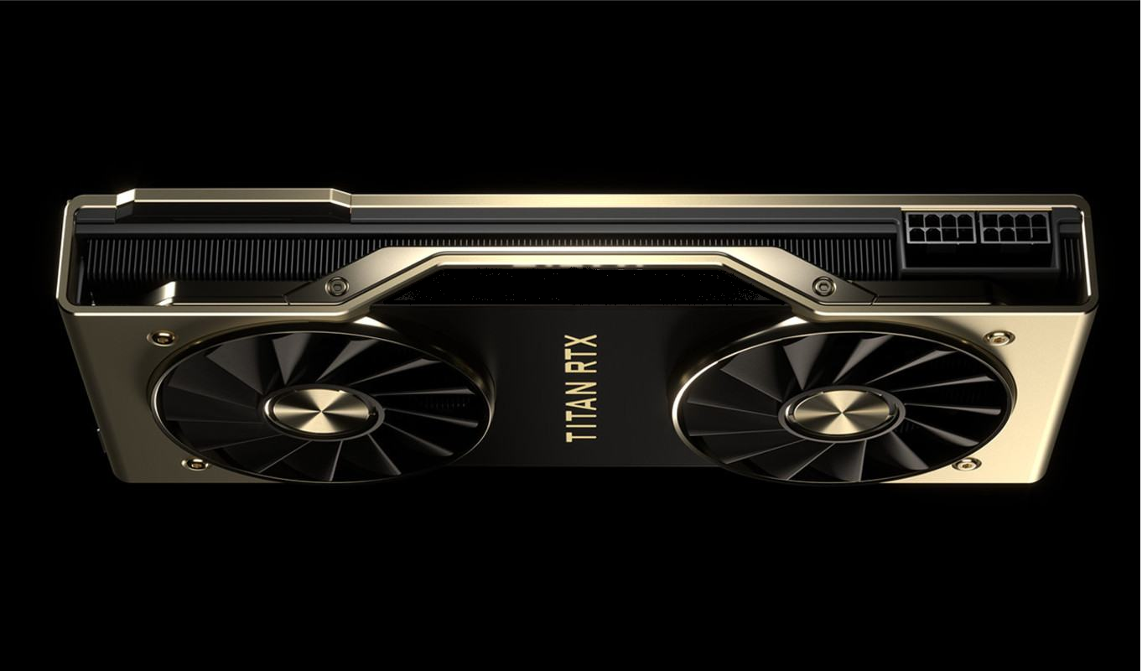
JUST PC
PC – Simple!

Slide 2


A set of software and website for proper assembly and
computer maintenance
GGNTU FUTURE
2023 year, GGNTU

Slide 3
Профиль проекта
Current status of the project (groundwork, what has already been done):
Competitors were analyzed..
The capacity and potential of the PC configuration sites market has been estimated.
There is a prototype website.
TRL Level: 4 - website prototype developed
Technological direction in accordance with the list of critical technologies of the Russian Federation:
Technology for tracking the rate of components on second-hand sites with smart configuration function
НТИ Marketplace:
Neuronet
Technet
Сквозные технологии:
Big Data
AI

Slide 4
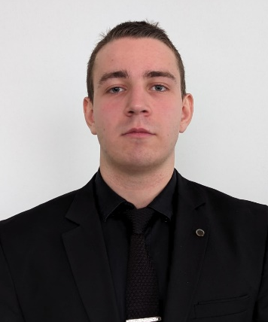
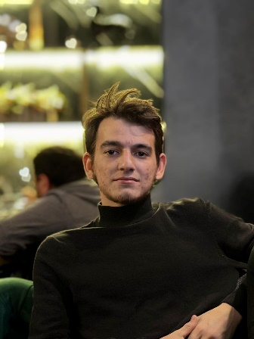
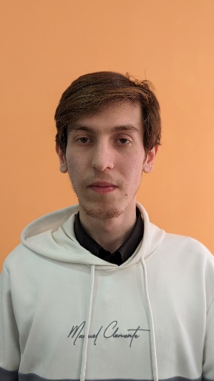
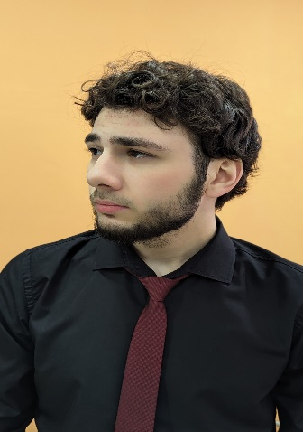
Project team
Project Leader
Dzhabrailov Deni
- Unti ID: 7535787
- Leader ID: 2900613
- Phone number: +7(928)887-7x-xx
- почта: DPerfomance@mail.ru
Aliev Islam
Project Role: Designer, Developer
Contact:+7(999)399-x1-6x
Work in progress: Website layout
Work experience: Graphic designer
Unti ID: х
Leader ID: 3113750
Bazaev Mohmad
Project Role: Developer
Contact: +7(935)01x-05-3x
Work in progress: Website layout
Work experience: х
Unti ID: x
Leader ID: 3113351
Baharchiev Samir
Role in the project: Manager
Contact: +7(989) 91x-52-0x
Work in progress: Analytics
Work experience: Project activities
Unti ID: x
Leader ID: 3113678

Slide 5
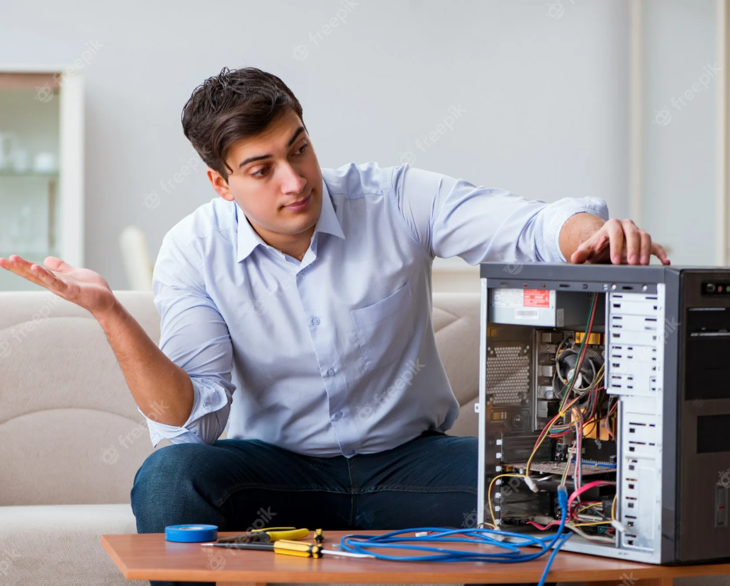
Relevance
A customer problem that the project solves:
The variety of components increases every year
Care of PC components becomes more difficult
PC selection and maintenance services are becoming more expensive
Existing options for solving the problem:
Site configurator
PC status monitoring software
Mobile application for remote monitoring

Slide 6
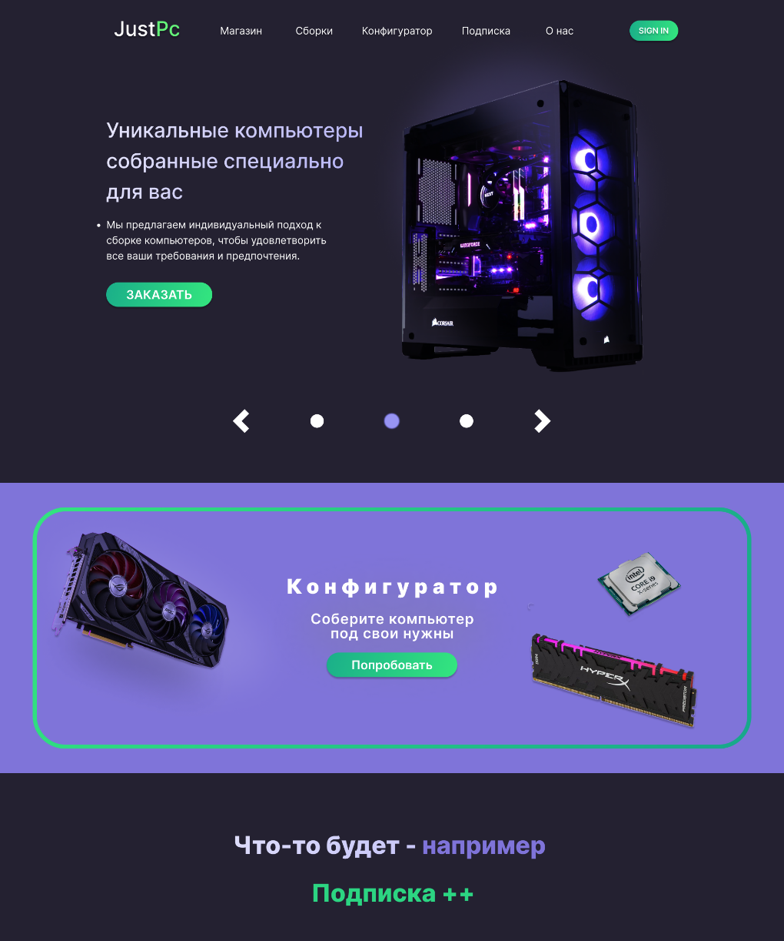
Product and Technology Description
What product (product/service/device/software/technology/process, etc.) will be sold:
Site services with smart configurator
Subscription to an app that makes PC care much easier and displays information in a user-friendly way
A description of the mechanics of how the customer uses the product:
A user goes to the site and
selects a PC configuration
The user downloads the application
and observes the status of the PC and its components
д

Slide 7

Product and Technology Description
Consumer segments:
Regular PC users
IT professionals
Cyberathletes
Commercial organizations
Customer Portrait:
Anton
21 years old
An aspiring cyber athlete
Have troubles using PC/playing the games
Prefers to save money when shopping
Wants a shiny computer

Slide 8
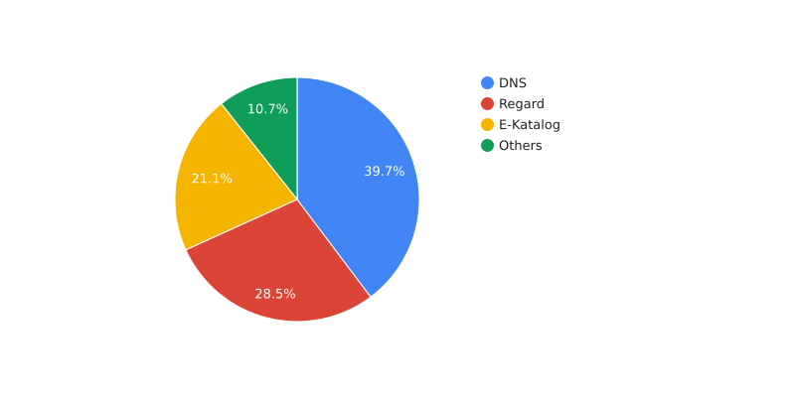
Market for the project
Market dynamics (for the last 3 years):
Target market share that the project plans to occupy:
9% of the configurators market
A brief description of the market (current year volume, geography):
Projected demand for PC assembly and condition monitoring services 2024-2026,
Over 1500 mln rubles.
Leaders according to Data Insight:
DNS – 205 mln
Regard – 147 mln
E-Katalog – 109 mln
Прочие – 55 mln

Slide 9
Business model based on Osterwalder's template
Partners Local, Private stores | Key Activities Subscription sales in a special application Implementation of a full-fledged system of ordering components and services from the site Software update | Value Proposition Providing an opportunity to use partly free maximally usable software. |  | Promotion channels of the future product Online advertising Digital content delivery Post.sales service by phone | Target audience Organizations, schools, IT developers, cyber athletes - all users in need of a PC
 | Key resources Developers Software licenses Premises Accountant, Lawyer Necessary equipment |  |  | Distribution channels for the future product Website Application Direct sales Partner sales
Costs Hiring of masters; Rental of space; Banking; Equipment and inventory; Expenses for third party services; Software licenses |  |  | Earns Income from the sale of subscriptions in the official application Income from a variety of customized services provided Percentage from the sale of affiliate components Income from advertising opportunities

Slide 10
Financial data
Income:
Income from purchase of subscriptions in the app
Percentage from the sale of partner PC components
Revenue from services and certain advertising contracts
Approximate price:
Monthly subscription - 199 rubles for 1 month
Maintenance services and detailed consultation when assembling a PC - from 500 to 5000 rubles.
Planned timeframe for return on investment:
4 years
Exit strategy for investors:
Multiplying the amount invested
Project targets | Units of measurement | Estimated values by periods
 |  | 2023y. | 2024y. | 2025 y. | 2026 y. | 2027y.
Revenue volume | mln. rub. | 0 | 1 | 4 | 15 | 30
Plans to attract investment and budget financing | mln. rub. | 1 | 3 | 0 | 0 | 0

Slide 11
Competitors
Key characteristics of the company/product | Name of Team/Project Product | Price monitoring | Mobile (app) monitoring of PC indicators | Monitoring of PC indicators | Configurator | Remote control
Monitoring | MSI Afterburner | Absent | Absent | Good monitoring system | Absent | Absent
Price database | E-Katalog | No monitoring of the used market | Absent | Absent | Incomplete | Absent
Configurator + price database | DNS | No monitoring of the used market | Absent | Absent | Present | Absent
Configurator + price database | Regard | No monitoring of the used market | Absent | Absent | Present | Absent
Our product | JUST PC | Present | Present | Present | Present | Present
Competitive advantages of the product
Site
Wide range of component selection
Up-to-date prices from all marketplaces and second-hand sites
Detailed advice from experienced specialists
App
Clear and comprehensive monitoring
Possibility of remote PC control
Possibility of remote PC upgrade
Possibility of remote monitoring of PC parameters

Slide 12
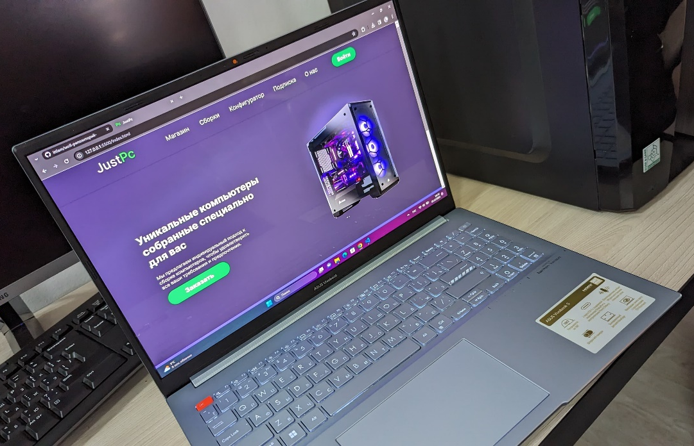
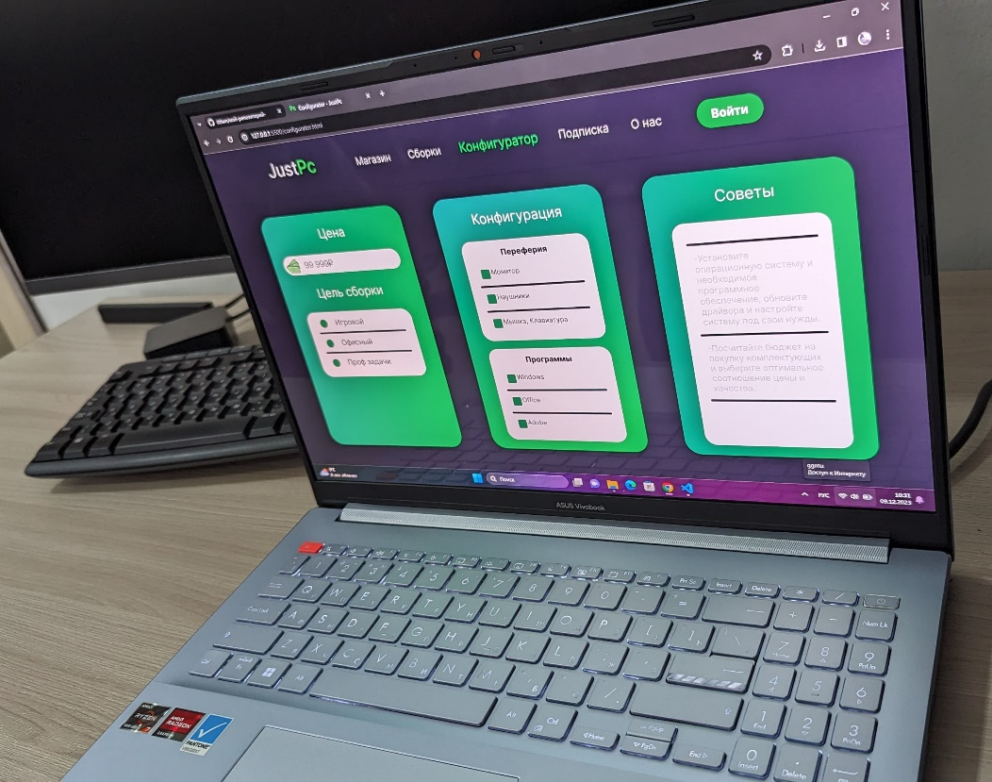
Prototype demonstration
JUST-PC!
The selection of the desired configuration and the main page of the site is implemented at an early stage
ПК - Просто!

Slide 13
Startup project calendar plan
Name of stage and timeframe | List of stage works | Duration of the stage, months. | Approximate cost, rubles.
Stage 1. 11.23y. – 03.24y. | Working on the website. Working out the database of all components and smart configurator | 4 | 600 000 rub.
Stage 2. 03.24y. – 07.24y. | Working on the software. Output of monitoring indicators and analysis of the PC system status | 4 | 1 550 000 rub.
Stage 3 07.24y. – 12.24y. | Working on a mobile app. Organization of remote control, update and output of PC indicators | 5 | 1 400 000 rub.

Slide 14
Project Risks
Technological risks
Market risks
Risks at the level of uncertainty
Risks are not present
PC – Simple!

Slide 15
Thank you for your attention!
GGNTU FUTURE
2023 year, GGNTU

