Slide 1
Emotional Voice Production
Ian Iakubchik
Anna Iakubchik
Yuri Lipin

Slide 2
Overview
Robots can speak using Text-to-Speech (TTS) systems
  One phrase is always pronounced the same way
  No emotions
Humans convey much information in emotions
Our idea:
  Develop a system to alter the intonation to represent the necessary emotions
  An add-on to TTS

Slide 3
Current progress
Successfully transferred the emotional information between two recordings of the same phase said by different people

Slide 4
Background
Emotion recognition: much progress
  Artificial Neural Networks [1]
  Hilbert envelopes [2]
Emotional speech production: not easy

Slide 5
Emotions
Developed to adapt more successfully to living conditions
Ekman (1970): several emotions are universal
sadness, disgust, despise, contempt, surprise, joy
J. Russel’s 2-dimensional model: valence and arousal
Kiselyov (2012): “cognitive emotion schemes” are used for emotion detection
[1] A. Minayev, I. Sartdinov, V. Kotlyarova, “Using artificial intelligence for the problems of psychology”, “Modern view on science and education” proceesings, Moscow, published by “Pero|, 2020. (in Russian)
[2] Timofey Alyoshin “Emotion speech recognition with sound modulation theory functions”, Eurasian Union of Scientists vol. 4(25) 2016. (in Russian)

Slide 6
Emotional voice reconstruction
Multi-step process with a lot of uncertainty
We transfer the emotions from sound to sound (learning-by-analogy approach)
[3] V. Kiselyov “Automatic detection of emotions in speech”, Educational technologies, vol.3, 2012. (in Russian)

Slide 7
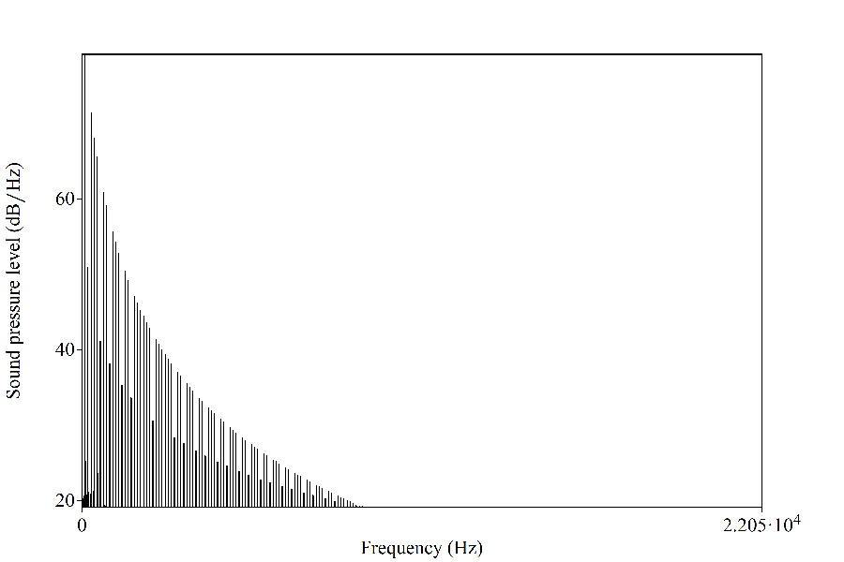
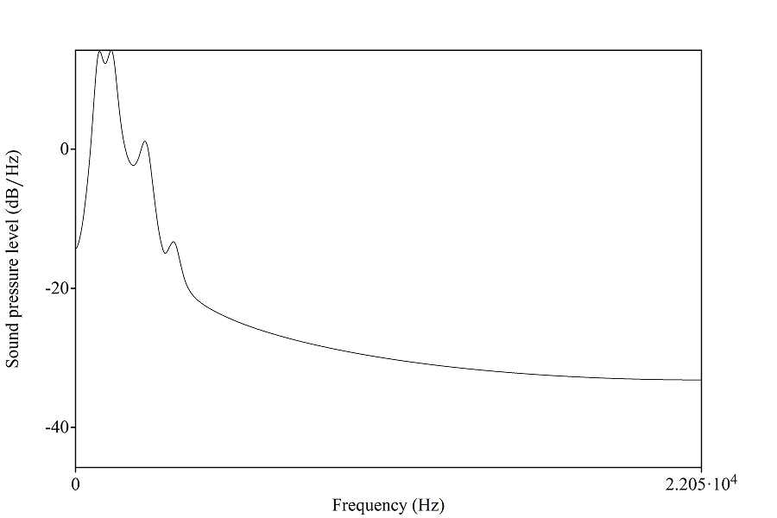
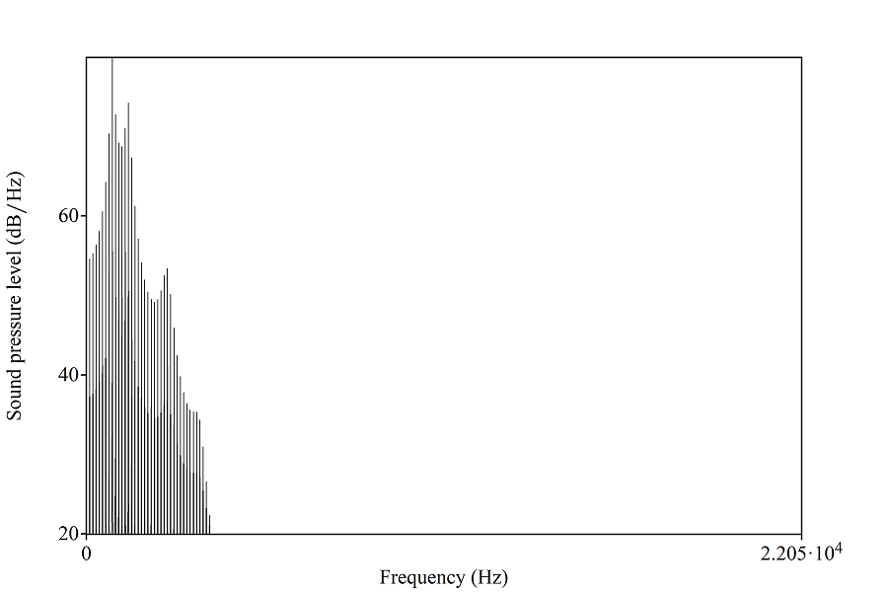
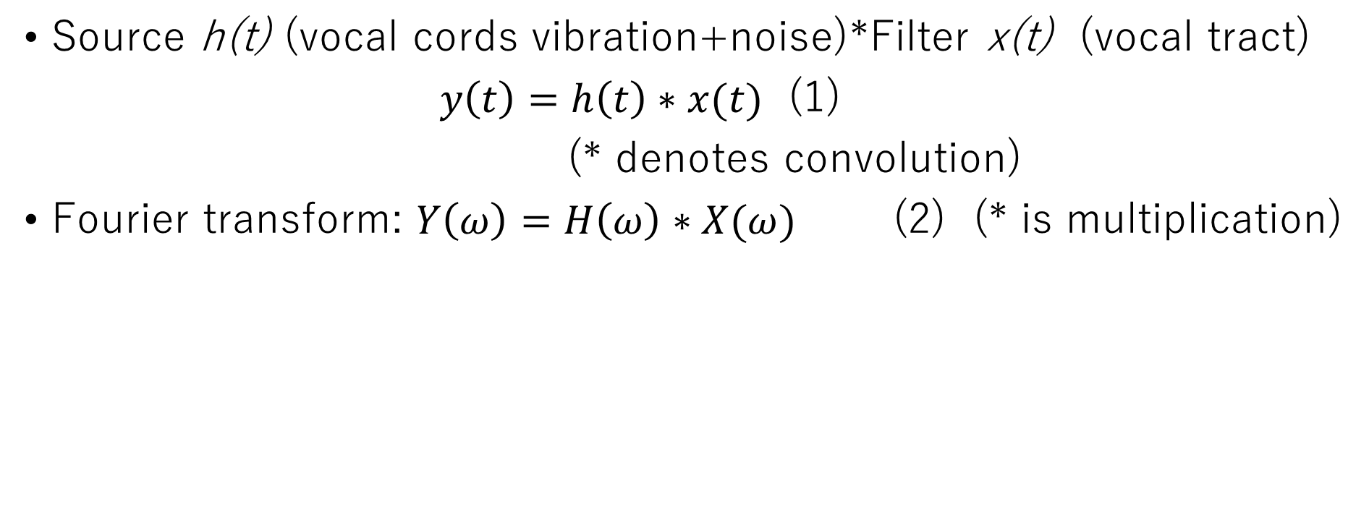
Source-filter model of speech production
[4] Chiba, T.; Kajiyama, M. (1942). The Vowel: Its Nature and Structure. Tokyo: Tokyo-Kaiseikan Pub. Co., Ltd.
[5] Fant, G. (1960) Acoustic theory of speech production, The Hague, The Netherlands, Mouton. M. Young, The Technical Writer’s Handbook. Mill Valley, CA: University Science, 1989.
Source h(t) (vocal cords vibration+noise)*Filter x(t) (vocal tract)
$y\left(t\right)=h\left(t\right)∗x(t)$ (1)
(* denotes convolution)
Fourier transform: $Y\left(ω\right)=H\left(ω\right)∗X(ω)$ (2) (* is multiplication)
Fig. 1. Source example in the source-filter model. The fundamental frequency is 100 Hz. The source does not contain noise, which is normal for a vowel sound.
Fig. 2. Filter example in a source-filter model. The first two formants are 800 Hz and 1300 Hz, which corresponds to the vowel [a].
Fig. 3. Output example in source-filter model. The spectrum contains harmonics of source, amplified near formant frequencies.

Slide 8
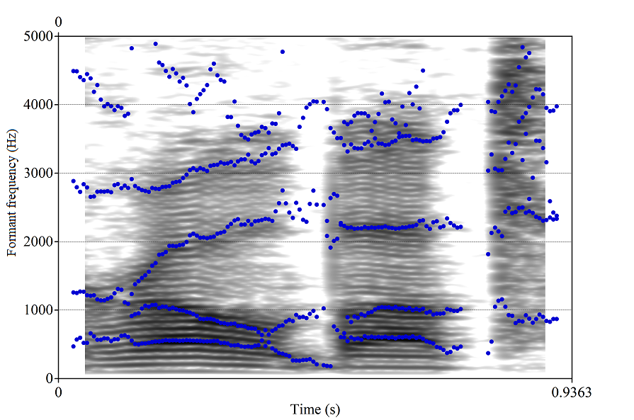
Spectrogram and formants
Each spectral slice follows source-filter model
Fig. 4. Spectrogram and formant contours of a recording of the word “robot”.

Slide 9
Pitch and formant detection
Auto-correlation method for pitch detection (Boersma 2000) [6]
Burg method for formant detection (Anderson 1978) [7][8]
[6] Paul Boersma “Accurate short-term analysis of the fundamental frequency and the harmonics-to-noise ratio of a sampled sound.” Proceedings of the Institute of Phonetic Sciences 17:97-110. University of Amsterdam.
[7] N. Anderson (1978): “On the calculation of filter coefficients for maximum entropy spectral analysis.” In Childers: Modern Spectrum Analysis, IEEE Press:252-255.

Slide 10
Pitch and Duration Manipulation
Overlap-add (Moulines&Charpentier 1990) [9]
[9] Eric Moulines & Francis Charpentier (1990): Pitch-synchronous waveform processing techniques for text-to-speech synthesis using diphones. Speech Communication 9: 453-467.

Slide 11
Our approach
We take the same phrase pronounced in different voices
We transfer emotions from “source” sound to “target” sound
  Result: “target” voice with “source” emotions
We leave the formants of the target sound intact because formants represent the contents and voice differences
We transfer the pitch contour (melody, intonation) and the rhythm of the source sound because they may represent emotions

Slide 12
Proposed method
We perform formant analysis on both sounds by Burg method mentioned above. We expect 5 formants in range of 0-5500 Hz, however we are going to use only first two of them.
Write both formants as functions of time and perform a cleanup in resulting formant information for further analyses. All data where a formant frequency changes more than 200 Hz during 0.03 s will be regarded as an unstable consonant region, unsuitable for comparison, and replaced by a linear interpolation based on surrounding values.
We use dynamic-time warping (DTW) technique to find the optimal correspondence between two time-series representing both sounds. Distances between all points of the emotion-source sound formant data and target sound formant data are calculated, then a restriction of monotonicity and Sakoe-Chiba band of 0.1 is imposed, and the optimal path is calculated by Viterbi algorithm. This allows for some pauses and rhythm irregularities while still maintaining some consistency. An example of DTW is shown on Fig. 5.
Based on result of DTW, a relative duration is calculated at all points and used for time manipulation to make the target sound’s rhythm match the emotion source’s. Then pitch analysis of both sounds is performed, the intonation of emotion source is changed so its average pitch matches target sound’s average pitch, the resulting intonation is used as a desired intonation for target sound.
A resynthesis using overlap-add method is performed.

Slide 13
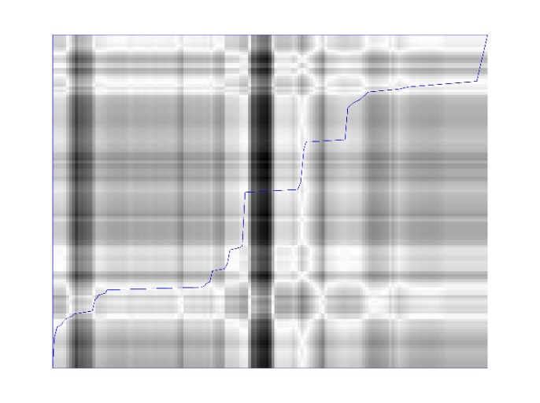
DTW (dynamic time warping)
t2
0 t1

Slide 14
Experiment
We asked students of Perm Institute of Culture to say one phrase with different emotions (3 “source” sounds)
  “Жаворонки звенят” [ˈʐav ər ənk ʲɪ.zv ʲɪˈn ʲat]: “Larks are singing”
We recorded the same phrase (1 “target” sound)
We transferred emotions from each “source” to our “target”
(3 results)

Slide 15
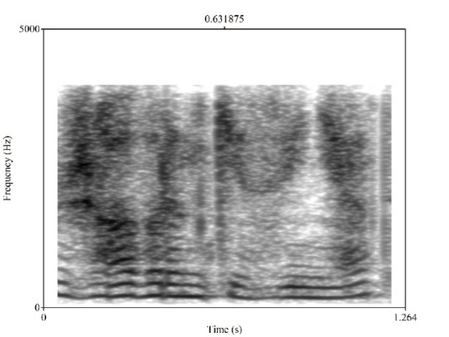
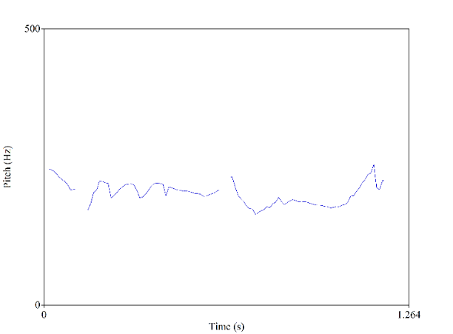
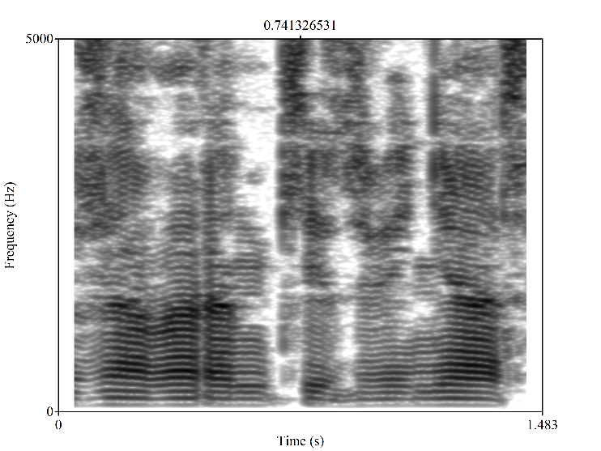
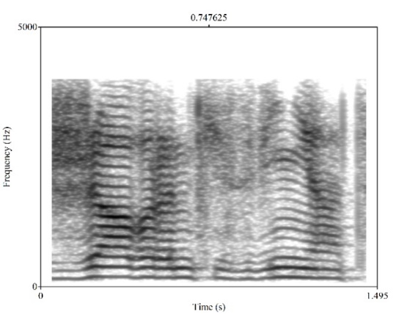
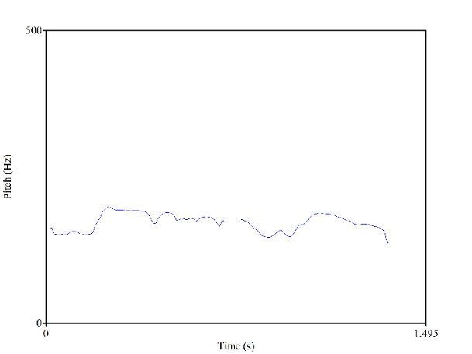
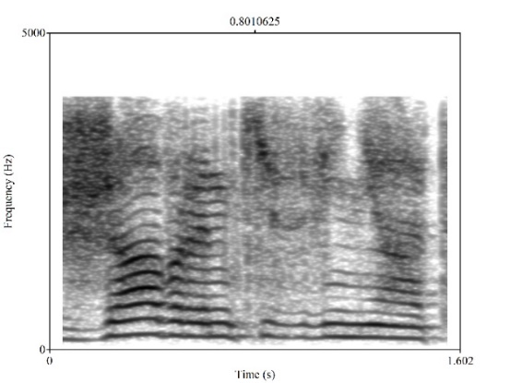
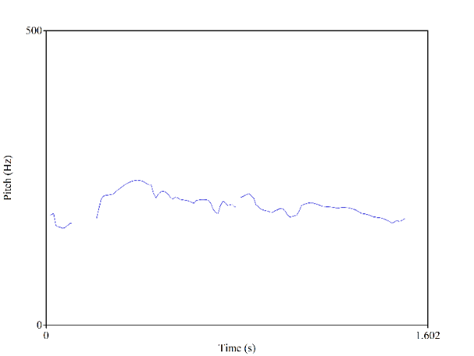
Input data
Fig. 6. Spectrogram of emotional source sound no. 1.
Fig. 9. Pitch contour of emotional source sound no.1.
Fig.12. Spectrogram of target sound.
Fig. 7. Spectrogram of emotional source sound no. 2.
Fig. 10. Pitch contour of emotional source sound no. 2.
Fig. 8 Spectrogram of emotional source sound no.3.
Fig. 11. Pitch contour of emotional source sound no. 3.

Slide 16
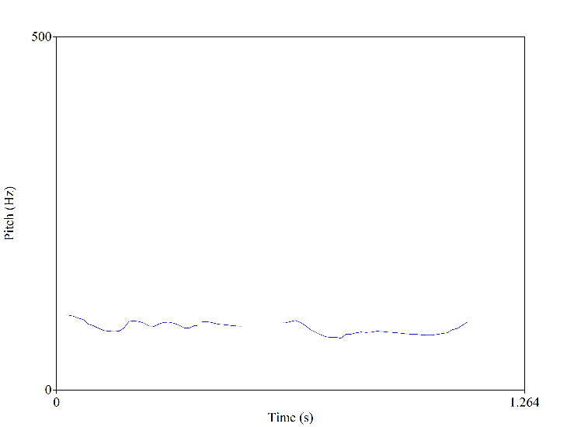
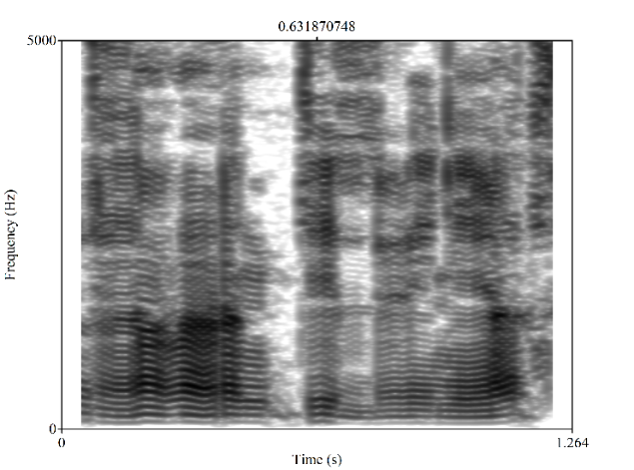
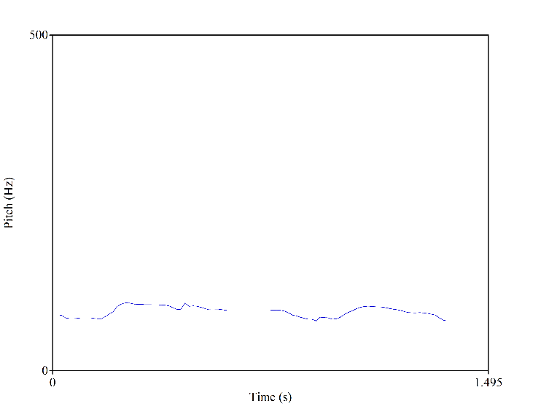
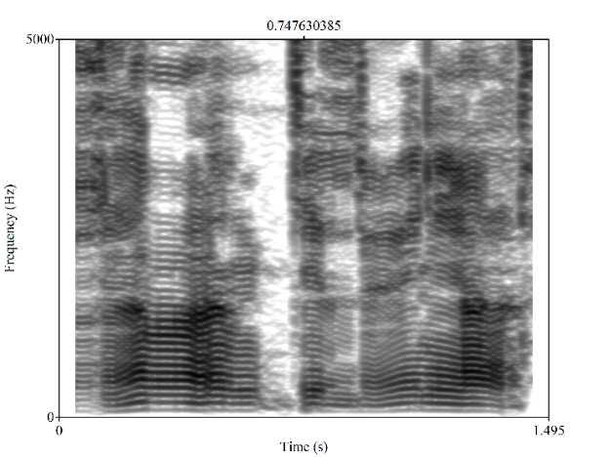
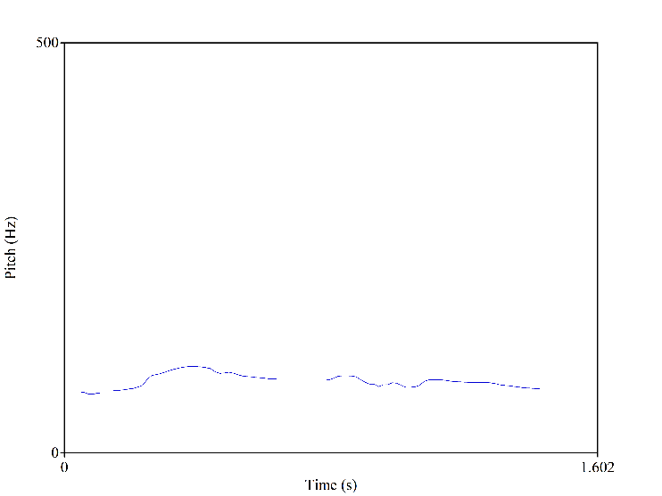
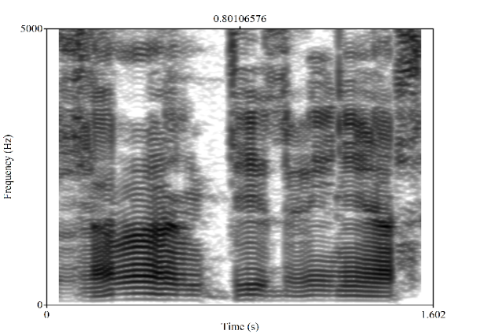
Input and results
Fig. 16. Pitch contour of result sound no.1.
Fig. 13. Spectrogram of result sound no. 1.
Fig. 6. Spectrogram of emotional source sound no. 1.
Fig. 9. Pitch contour of emotional source sound no.1.
Fig. 14. Spectrogram of result sound no. 2.
Fig. 7. Spectrogram of emotional source sound no. 2.
Fig. 17. Pitch contour of result sound no. 2.
Fig. 10. Pitch contour of emotional source sound no. 2.
Fig. 15. Spectrogram of result sound no. 3.
Fig. 8 Spectrogram of emotional source sound no.3.
Fig. 11. Pitch contour of emotional source sound no. 3.
Fig. 18. Pitch contour of result sound no. 3.

Slide 17
Results
The sound was repeating intonation patterns from source
Quite natural
Some irregularities in rhythm
  Comparison of formants is not perfect because formant frequencies differ between voices

Slide 18
Conclusion
Successfully transferred emotional content from one voice to another with help of automatic matching using DTW.
Future work: transfer emotions between different phrases
  Need a language model
  Some parts of intonation indicate emotions, some parts indicate content (stress, question, exclamation, or even different words in tonal languages), it heavily depends on a language

Slide 19
Commercial prospects
The great development of service robotics makes great demands on communication capabilities of humanoid robots. We look forward to entering the world market with our voice-output system. At the moment we are discussing our system with Promobot, ltd. in Perm. In case of successful development, they are ready to purchase our system for their robots. Promobot is the largest manufacturer of autonomous humanoid robots in Northern and Eastern Europe. More than 500 robots from Perm work all over the world. It is still difficult to estimate the cost of selling the system (it depends on which commercial model we will use to sell the product).

Slide 20
NEWS
The main result – Publication:
Ian Iakubchik, Anna Iakubchik, Yuri Lipin “Emotional Voice Reconstruction Based on Intonation Alteration”, ElConRus, IEEE, 2021.
https://ieeexplore.ieee.org/abstract/document/9396450

Slide 21





The team (key members)
Ian Iakubchik - team leader and academic supervisor. Education: 2015-2019 Yokohama National University, Bachelor of Engineering, The University of Tokyo, Department of Mechano-Informatics, Master of Information Science and Technology. Publications: "Implant Email Attack That Does Not Require URL Access by Target User", Proceedings of Computer Security Symposium, 2019. "Continuum Model Simulation and Congestion Reduction Control of Four-directional Pedestrian Flows assuming Scramble Crossing", DARS-SWARM, 2021. ElConRus, IEEE, 2021, "Emotional Voice Reconstruction Based on Intonation Alteration ", ElConRus, IEEE, 2021 "Acoustic Determination of Contact on the Exterior Surface of the Robot",. https://ieeexplore.ieee.org/abstract/document/9396486
https://ieeexplore.ieee.org/abstract/document/9396450
Anna Iakubchik - researcher. Enrolled in Master course of PNRPU (Perm National Research Polytechnic University), majoring in Autonomous service robots. Until 2021 - CEO of Energotechproject, ltd., an IT company. Experience and skills: IT analytics, leading a developer team, finance activity. Education: Perm Polytechnic Institute, Automated Control Systems. Publication: Ian Iakubchik, Anna Iakubchik, Yoshihiko Nakamura "Acoustic Determination of Contact on the Exterior Surface of the Robot"
Yuri Lipin – research advisor. Lecturer of Perm National Research Polytechnic University, PhD of Technical Sciences. A recent publication: Y. N. Lipin, I. V. Maksimova, Y. L. Tokarev, A. I. Tur, A. A. Yuzhakov: “Quality estimation of least-square method in voice morphing”, Neurocomputers: development and applications, 2019. Vol. 21, no. 3, pp. 42-49. Many publications in fields of sound signal processing, face recognition etc.
Dmitrii Ostrovskii - system administrator, DevOps. Until 2017 - DevOps at Energotechproject ltd. Experience, skills: working with various platforms and operating systems, ensuring security, technical support. Education: Perm State Technical University, Automated Control Systems.
Notes:
21

