Slide 1
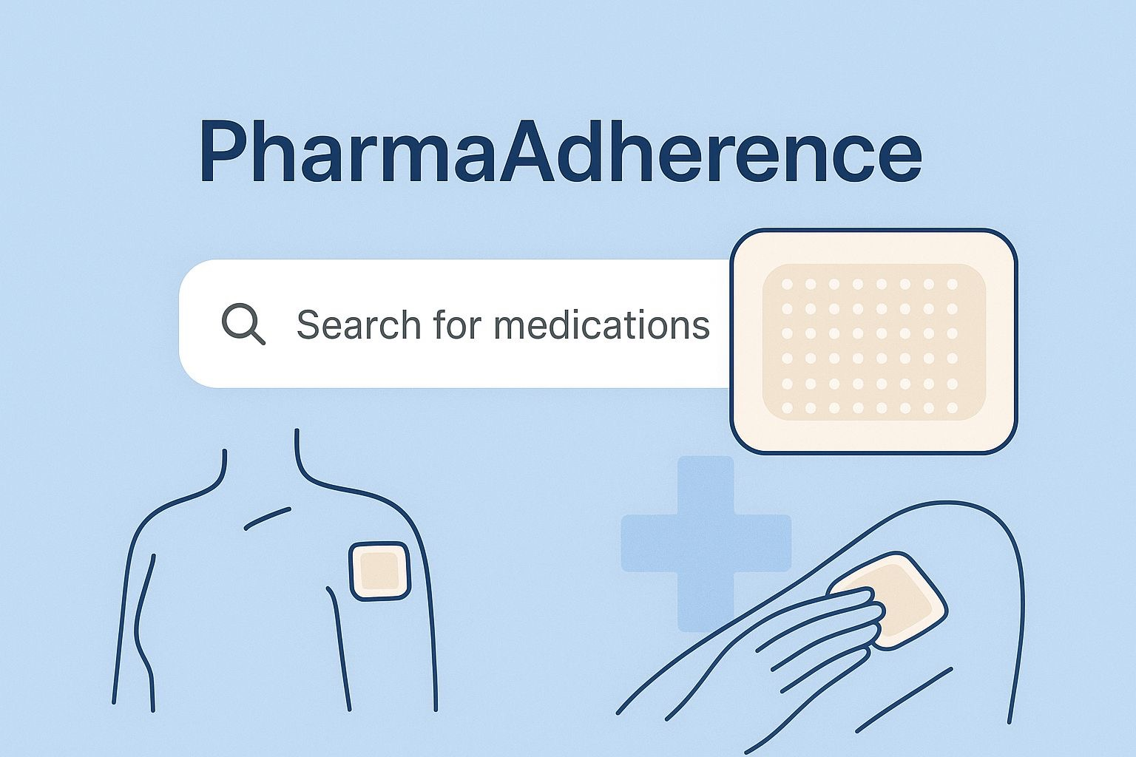
PharmaAdherence Patch
Supervisor:Professor Fetisova Angelica
Speaker : AL-ALwani Noralhuda Mazin Jabbar

Slide 2
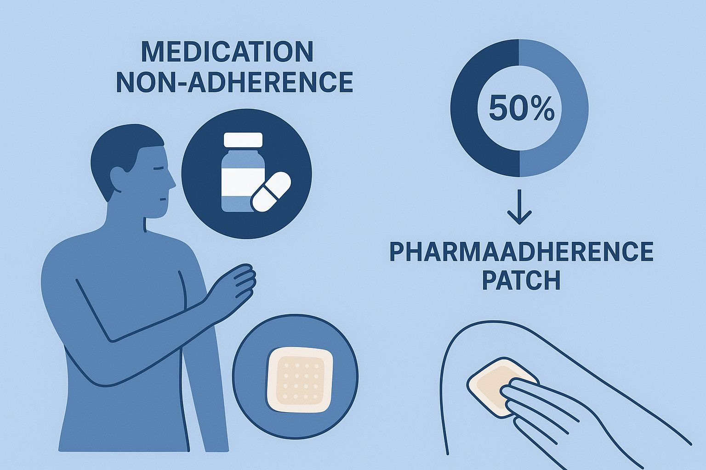
Introduction:
Medication non-adherence remains a critical challenge in healthcare, with approximately 50% of patients failing to take their medications as prescribed. This non-compliance contributes to suboptimal clinical outcomes, disease progression, and increased healthcare costs. Traditional adherence monitoring methods, such as pill counts and patient self-reports, are often unreliable.
The PharmaAdherence Patch represents a transformative solution by integrating biosensing, smart drug delivery, and digital monitoring into a single wearable platform. It aims to provide continuous adherence tracking and personalized feedback, addressing both patient behavior and pharmacokinetic variability.

Slide 3
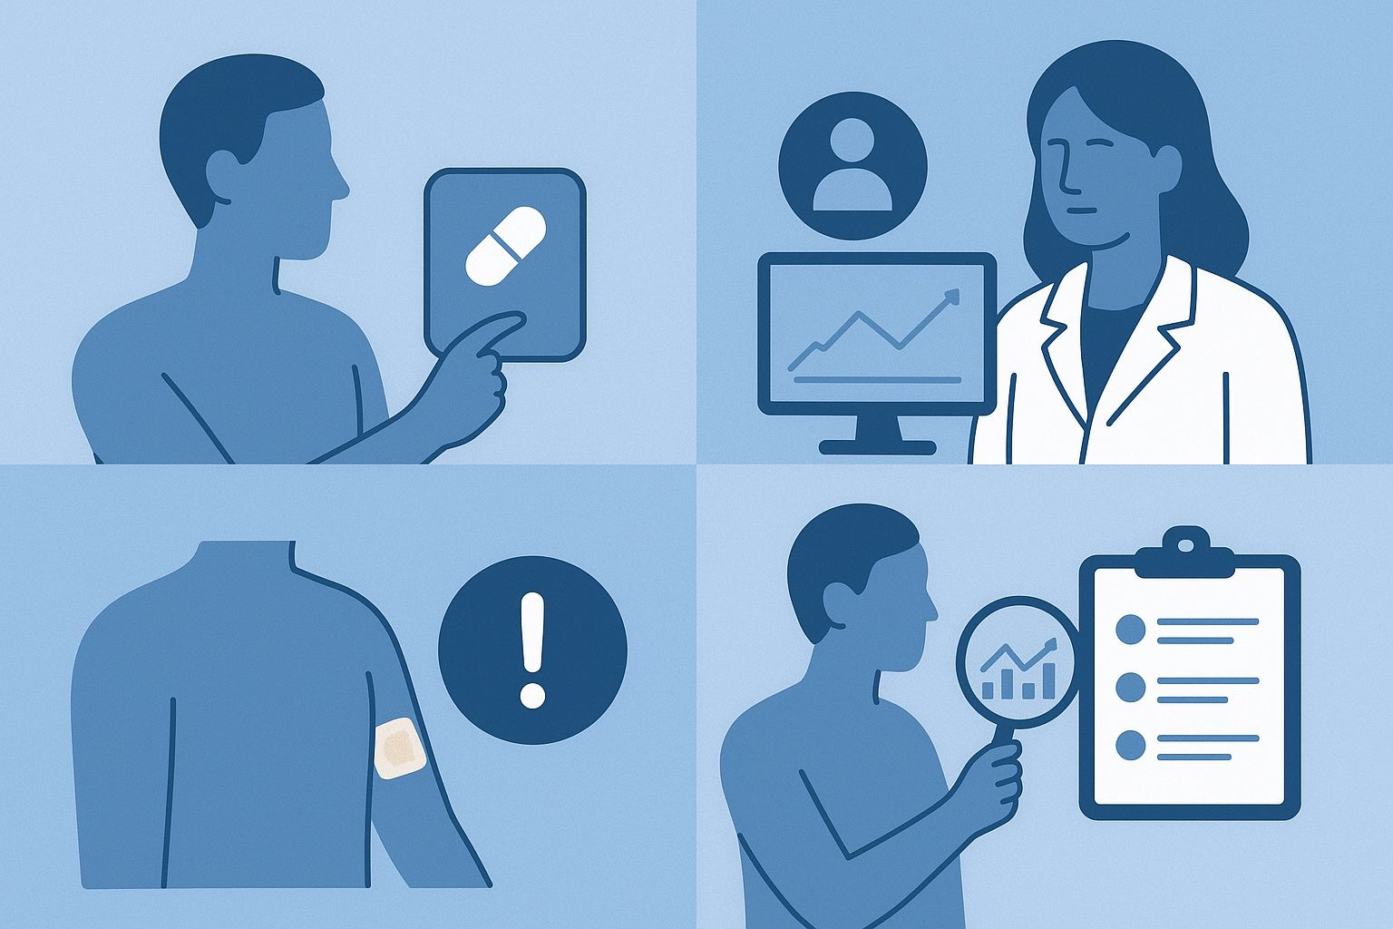
System Architecture and Design
1. Improved Medication Adherence:
Real-time monitoring ensures patients take medications correctly.
Automated reminders reduce forgetfulness, a primary cause of non-adherence.
2. Personalized Therapy:
Data-driven insights allow clinicians to adjust dosages individually.
Can track response to therapy in real-time, allowing precision medicine approaches.
3. Reduced Adverse Events:
Monitoring drug levels reduces the risk of toxicity or subtherapeutic dosing.
Early detection of non-adherence or physiological anomalies enables timely intervention.
4. Enhanced Research Opportunities:
Large-scale, anonymized data can support clinical trials.
Insights into adherence patterns and pharmacodynamics improve drug development and healthcare delivery research.

Slide 4

Potential Applications:
Chronic Disease Management
Diabetes, hypertension, cardiovascular diseases, HIV, and psychiatric disorders.
Polypharmacy Management
Ideal for elderly patients or those taking multiple medications.
Remote Patient Monitoring
Supports telemedicine initiatives and home-based care.
Clinical Trials
Provides accurate adherence data, reducing variability in pharmacological studies.

Slide 5
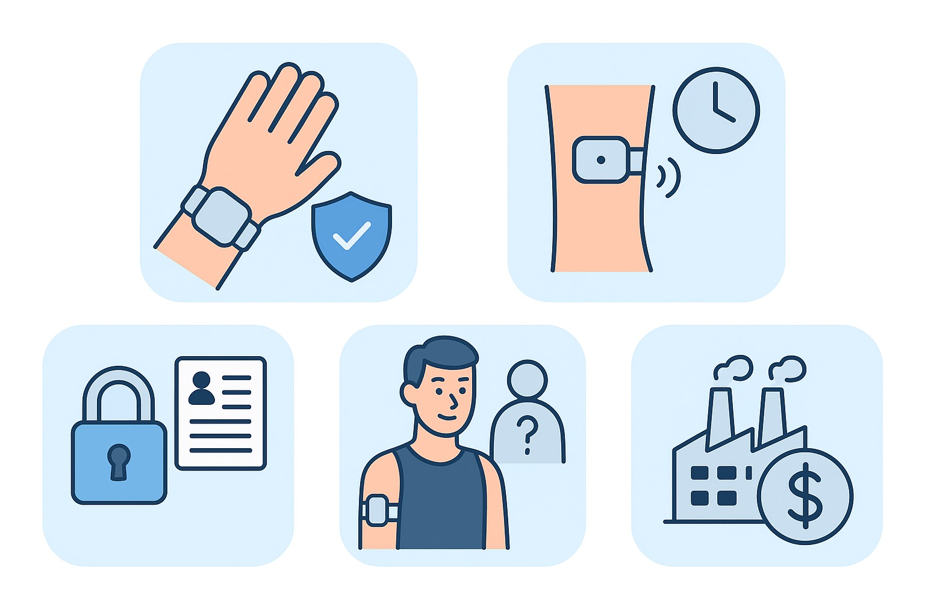
Challenges and Considerations
Biocompatibility: Ensuring materials are safe for long-term skin contact.
Sensor Calibration: Maintaining accuracy over extended periods.
Data Privacy & Security: Ensuring compliance with GDPR, HIPAA, and other regulations.
Patient Acceptance: Wearability, comfort, and aesthetic factors impact adoption.
Cost & Scalability: Manufacturing challenges for large-scale production while keeping costs manageable.

Slide 6
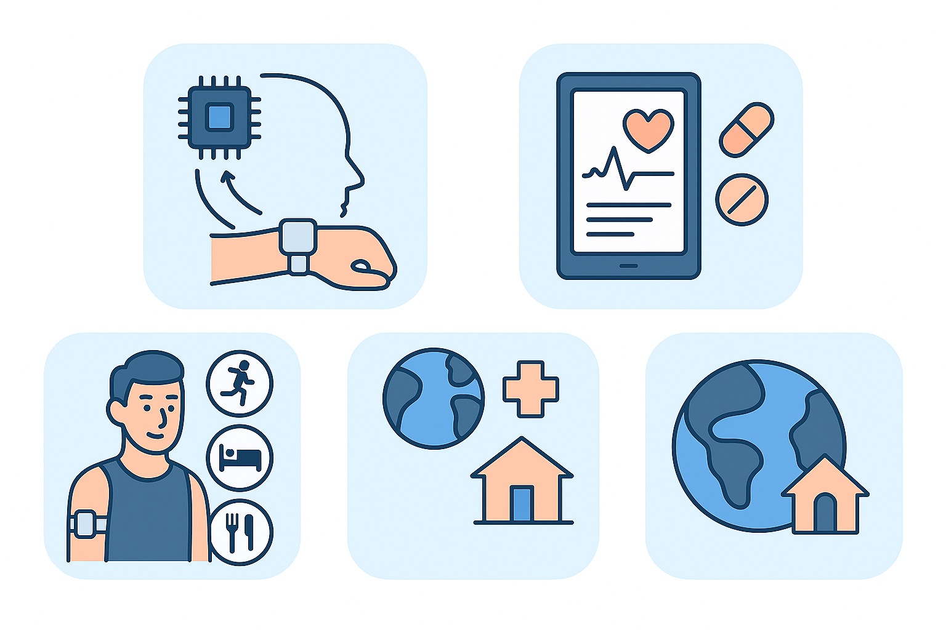
Future Directions
Integration with AI to predict adherence patterns and potential adverse events.
Multi-drug monitoring and adaptive release based on real-time pharmacodynamics.
Combination with lifestyle monitoring (activity, sleep, diet) to contextualize adherence.
Expansion to global healthcare settings, including low-resource environments.

Slide 7
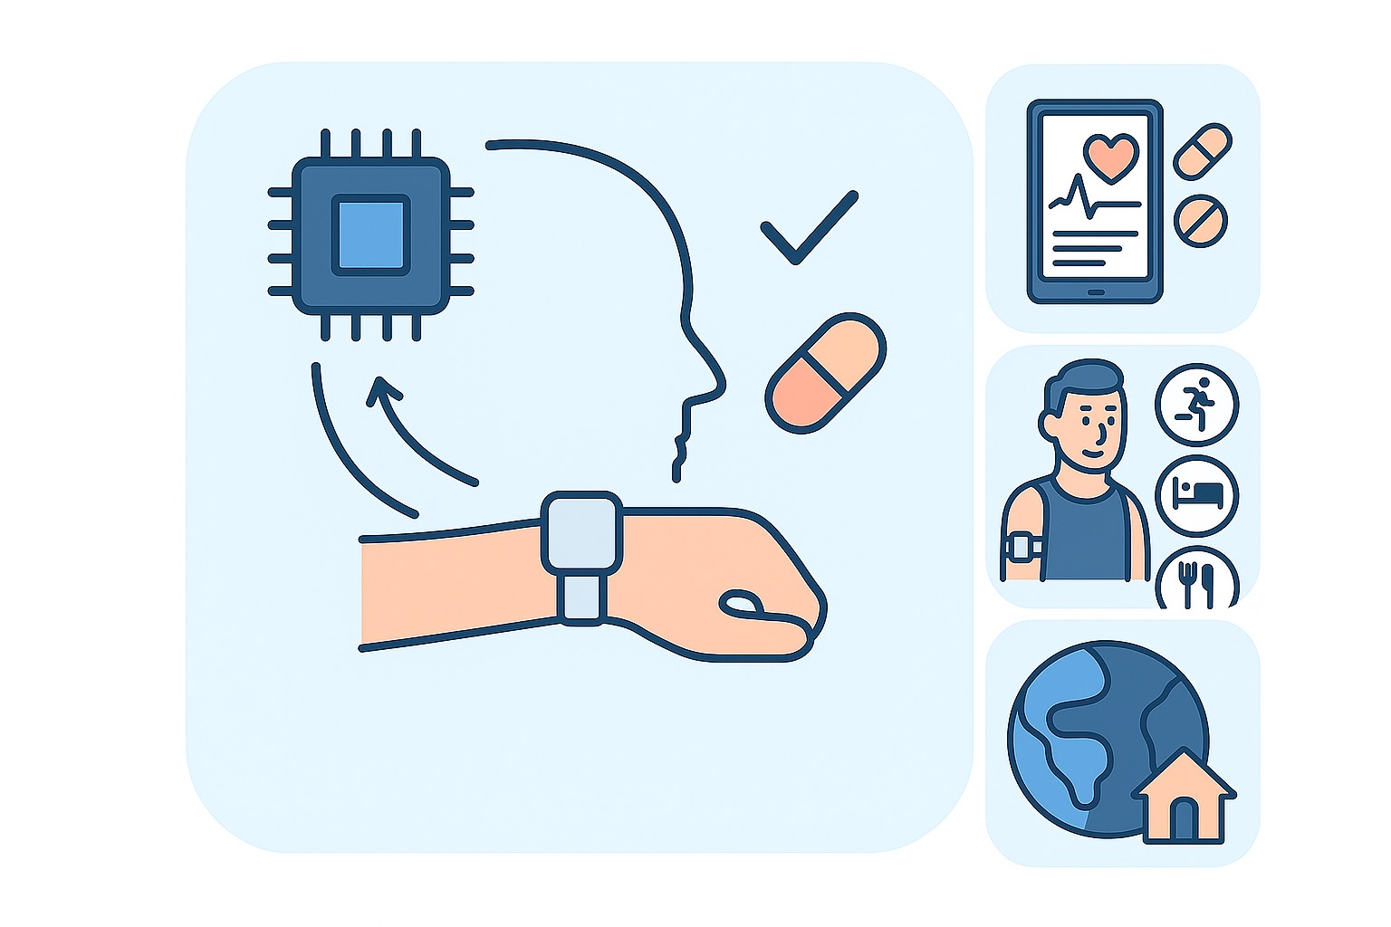
Conclusion:
The PharmaAdherence Patch represents a paradigm shift in patient-centered therapy. By combining wearable biosensors, smart drug delivery, and digital health connectivity, it addresses both behavioral and physiological aspects of medication adherence. This technology promises not only to improve clinical outcomes and reduce healthcare costs but also to enable novel research avenues in precision medicine and pharmacology.

Slide 8

Contact Information:
Phone: +964 783 228 8755
Email: al-alvani_n_d@student.sechenov.ru

