Slide 1
Pantomime
Sign language translator
Innopolis University

Slide 2


Problem

Slide 3
Problem
13.000.000
people with hearing disability
in Russia
300.000
can use Russian Sign Language

Slide 4
Problem
Deaf people in Russia are limited in communication with others.

Slide 5


Competitors

Slide 6
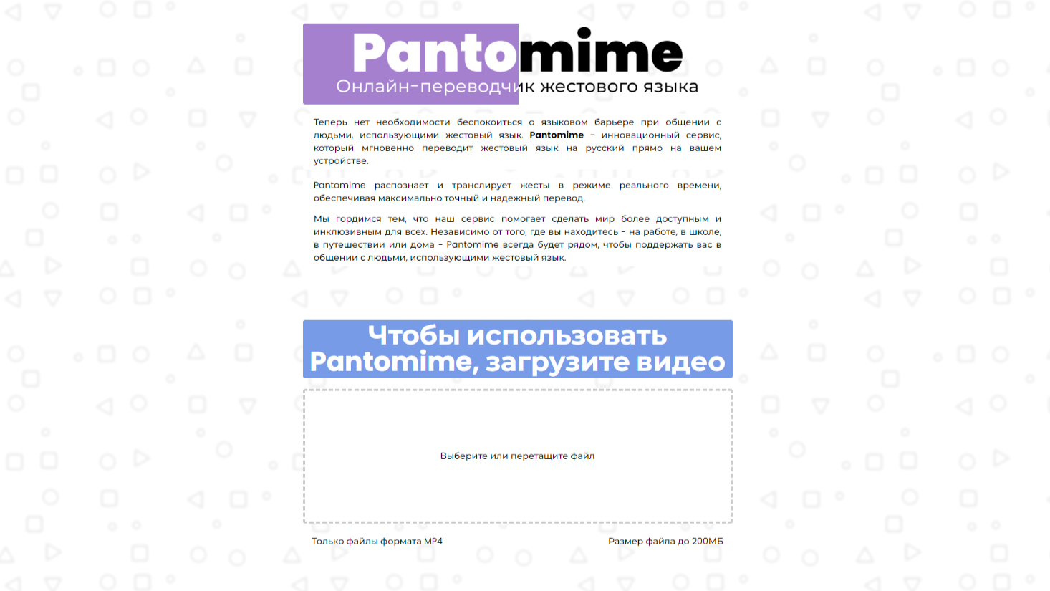
Solution

Slide 7
Data
&
Models

Slide 8
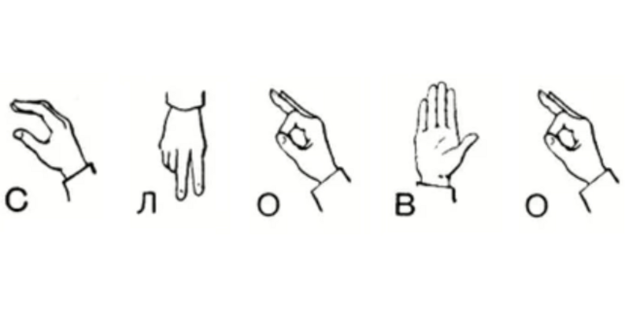
Data
Sign Language MNIST dataset
MNIST: https://www.kaggle.com/datasets/datamunge/sign-language-mnist
Slovo: arXiv:2305.14527 [cs.CV] https://doi.org/10.48550/arXiv.2305.14527

Slide 9

Models
We gradually changed model increasing its features
  MNIST model

Slide 10
Models
We gradually changed model increasing its features
  MNIST model
  Fine-tuning ResNet3D on our dataset

Slide 11
Models
We gradually changed model increasing its features
  MNIST model
  Fine-tuning ResNet3D on our dataset
  Script for real-time translation

Slide 12
Frontend

Slide 13
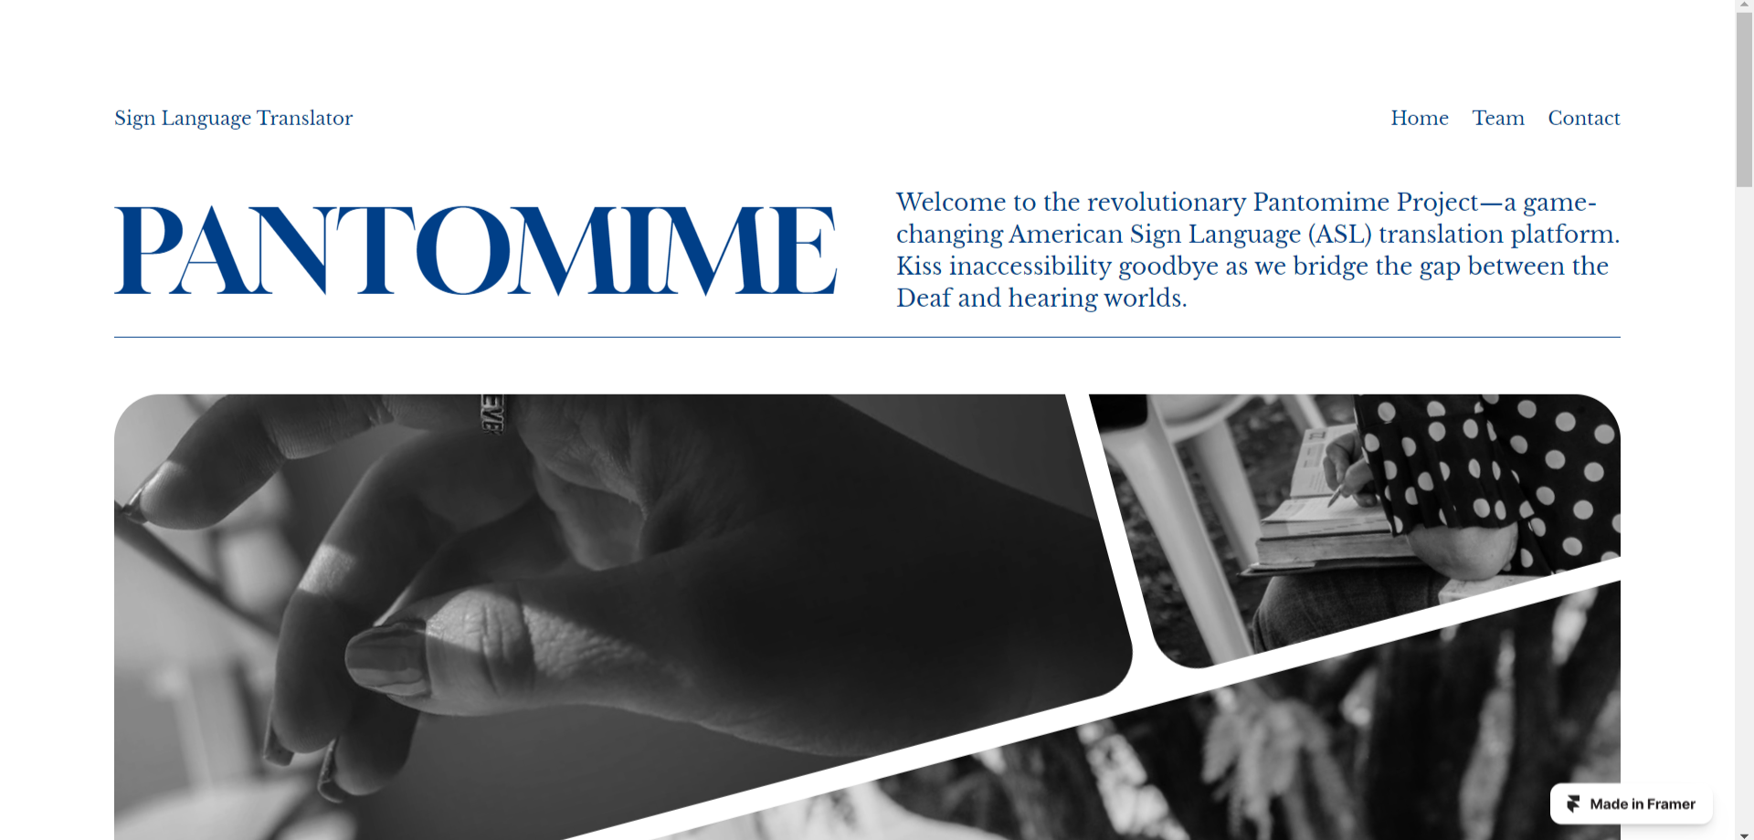
Framer

Slide 14
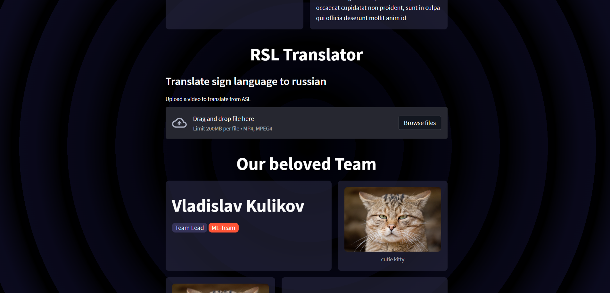
Streamlit

Slide 15
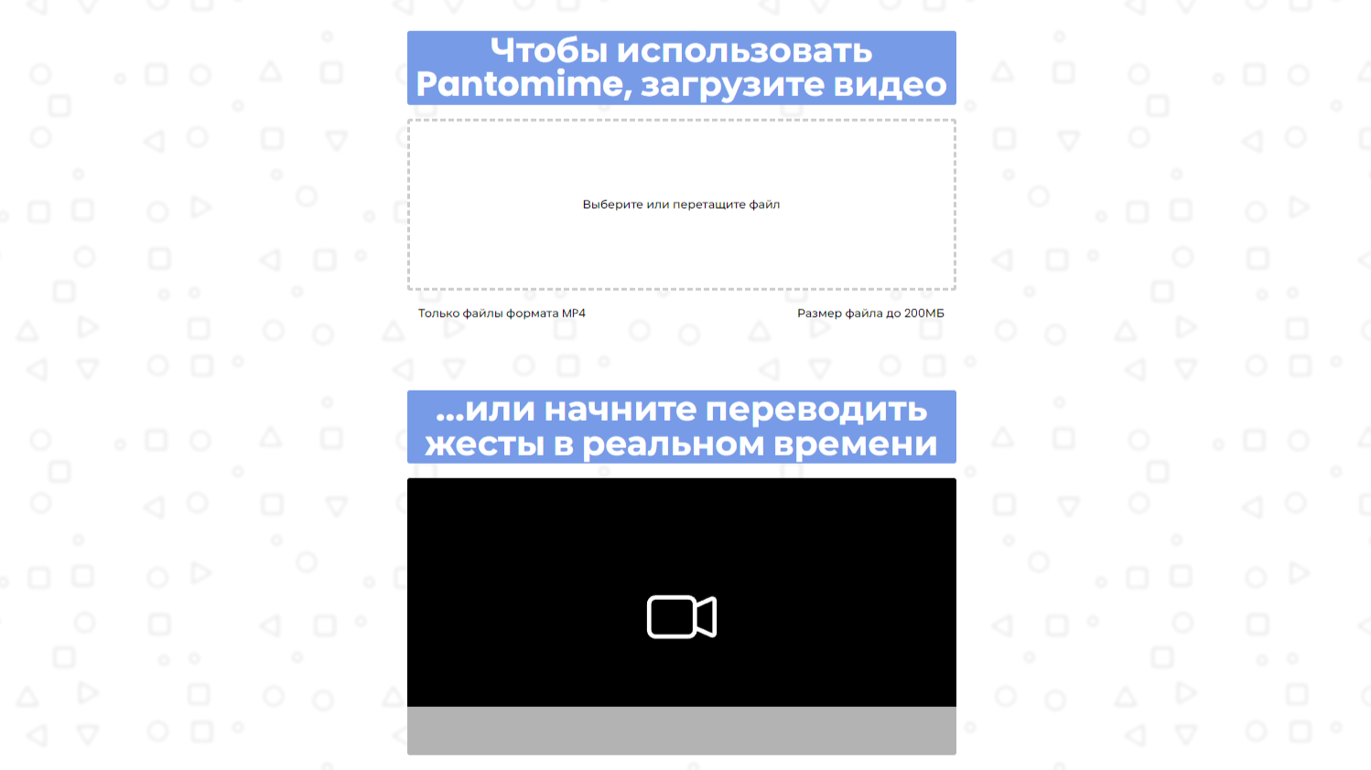
HTML CSS JS

Slide 16
Backend

Slide 17
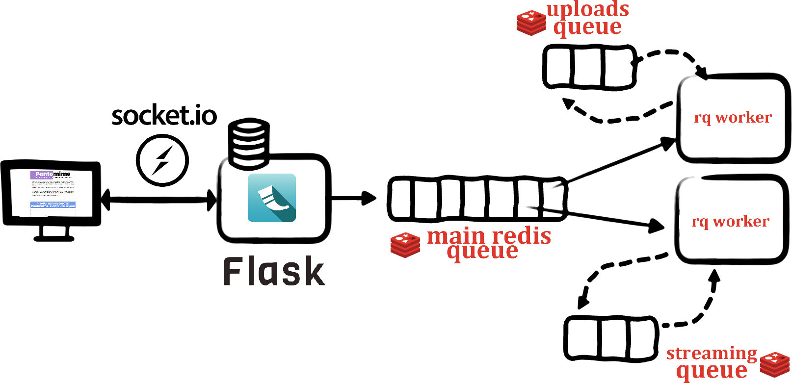

Slide 18
Demo

Slide 19


Feedback

Slide 20
Future Development
  Creating an application for studying RSL
  Participating in the Innopolis University accelerator, where we can develop our project
  Using mediapipe framework, which can change the performance of our model

