Slide 1











SUMMER SCHOOL
PROJECT
"Phygital Space in TSU"
TEAM OF THE PROJECT:
Daria Korshunova, Institute of Law and Management
Andrey Korostin, Institute of Applied Mathematics and Computer Science
Irina Fomicheva, Polytechnic Institute
Ksenia Korneeva, Institute of Law and Management

Slide 2

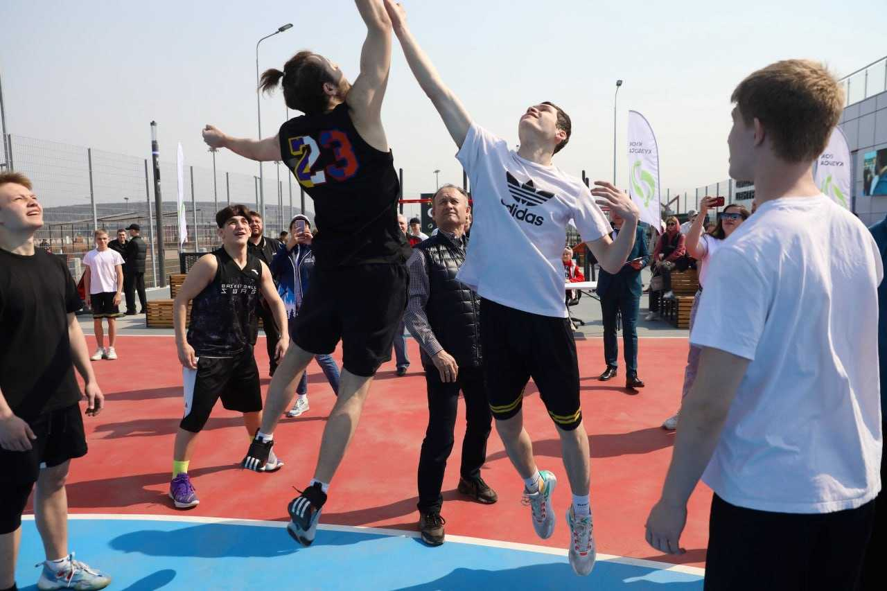
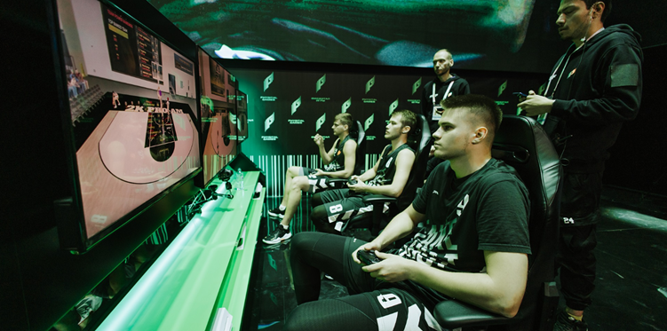
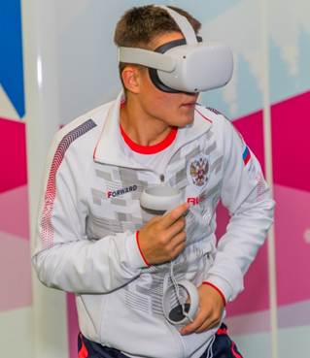
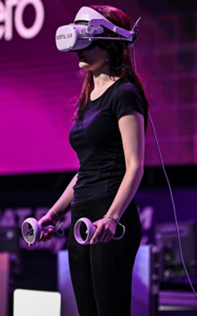

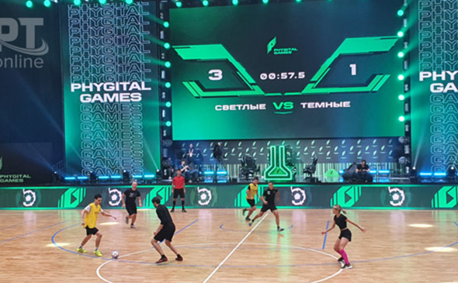
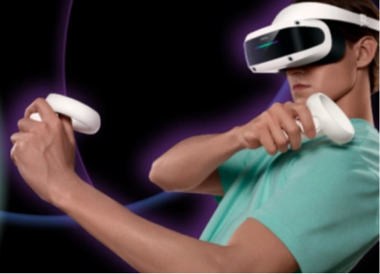
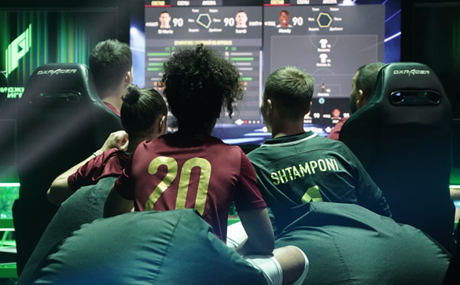

Physical +digital
Tula State University| Space for New Opportunities
2

Slide 3
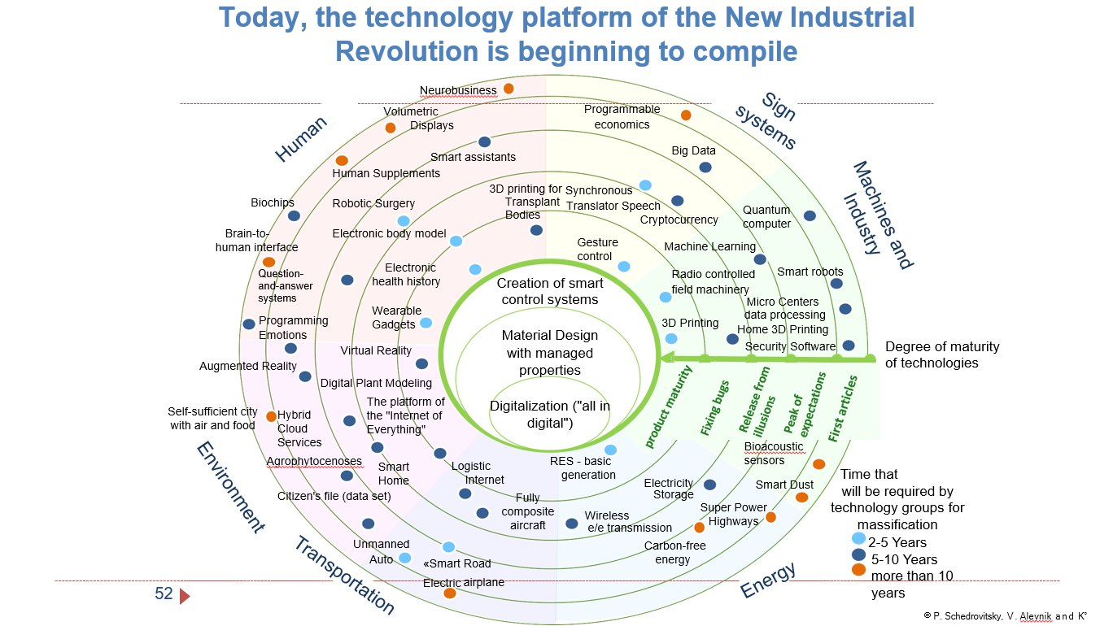
SITUATION ANALYSIS
Tula State University| Space for New Opportunities
3

Slide 4

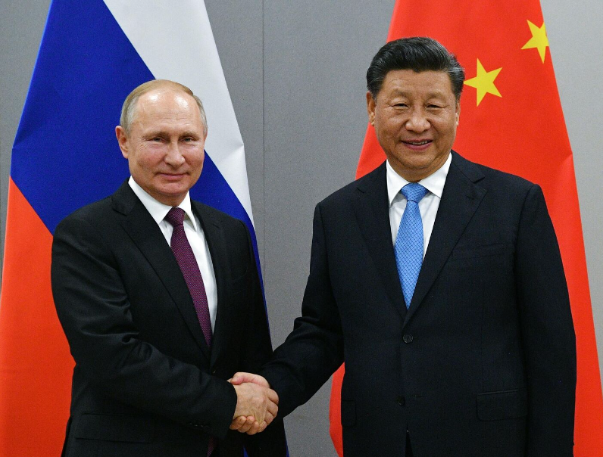

SITUATION ANALYSIS
Positive Trends:
New direction
Partnership with China
Phygital sport has been officially recognized in Russia by the Ministry of Sports in January 2023
Big demand for cyber sports
Universities open phygital platforms, master classes and forums
Growth of people’s sport involvement in program "Development of physical culture and sports" approved by the Government of the Russian Federation
Tula State University| Space for New Opportunities
4

Slide 5

SITUATION ANALYSIS
Negative Trends:
Economic situation in the context of sanctions
Negative public perception
Bad reputation from cybersports betting scams
Tula State University| Space for New Opportunities
5

Slide 6
SITUATION ANALYSIS
Cases:
The first phygital competition in Kazan, 2022,
The phygital Club in Kemerovo,
The Phygital Day in Tomsk, 2023,
Sechenov’s Phygital Academy, Moscow.
Tula State University| Space for New Opportunities
6

Slide 7


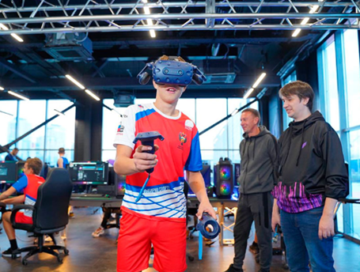
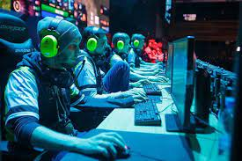
BENCHMARKS
Kazan Phygital Competition, 2022:
+ Media and bloggers involvement;
+ Elongation for 2024;
+ Modern popular sport venue;
+ Active social networks;
+ Eminent cyber sportsmen engaging;
– Few disciplines (racing, hokey, martial arts).
Tula State University| Space for New Opportunities
7

Slide 8
BENCHMARKS
Kemerovo Phygital Club:
+ Place organization (sport place & cybersport club);
+ Partners: MFA “Kuzbass”, “KuzTSU”, “The Future Games”, “Sibe”;
- Weak PR campaign;
- Social net inactivity;
- Limited count of training places (2 – 20, depends on discipline);
- One regional completed competition only (“Kuzbass Cup”).
Tula State University| Space for New Opportunities
8

Slide 9
BENCHMARKS
Tomsk Phygital Day:
+ Partners: “Gazprom”, VTB, MTS, “Tinkoff”, and ICAE;
+ Family festival (popularization among different generations);
+ Strong PR campaign;
+ Based on the University;
- Too short program (1 day);
- Phygital sport’s conception stays unreview.
Tula State University| Space for New Opportunities
9

Slide 10
BENCHMARKS
Sechenov’s Phygital Academy:
+ Participation in the “Priority 2030" program;
+ 8 different disciplines;
+ Volunteer program "Games of the Future 2024" implementation;
+ Part of a successfully functioning sports center;
- Lack of up-to-date information about the academy activities.
Tula State University| Space for New Opportunities
10

Slide 11
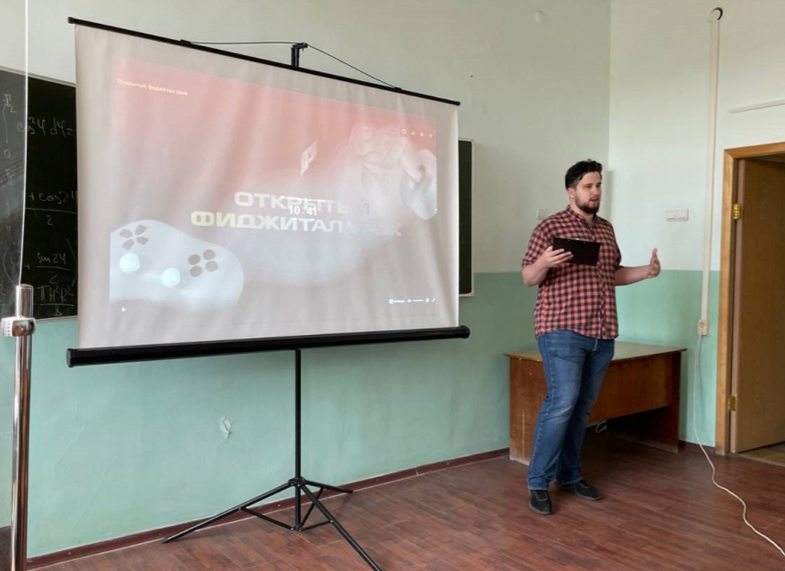

PROBLEMATIZATON
Current situation
Phygital becomes popular
Phygital centers are opening in Russia
Universities are interested in Phygital competitions and technologies
Tula State University| Space for New Opportunities
11

Slide 12
PROBLEMATIZATON
Problem 1
Support and popularization of sports and modern technologies in Russia among the youth.
If a person has a desire - he is looking for an opportunity, if there is no desire - a reason.
Socrates
Tula State University| Space for New Opportunities
12

Slide 13

PROBLEMATIZATON
Problem 2
Ensuring the stable functioning and development of the established structure
Tula State University| Space for New Opportunities
13

Slide 14

PROBLEMATIZATON
Tasks of Problem 2
Buy and maintain expensive equipment and software
Search high-qualified trainer and provide their salary
Pay constant expenses
Tula State University| Space for New Opportunities
14

Slide 15

PROBLEMATIZATON
Model of Solution
It is possible to rent equipment for Phygital class and use of domestic software
Internship of university students through individual lessons in existing centers and attracting athletes and cyber sportsmen of our city
Fundraising by sponsors and paid visit for third persons.
Tula State University| Space for New Opportunities
15

Slide 16
Trend 2
Trend 1
Solution
Growth prospects
Problem 1
Problem 2
Problem 1
Problem 2
Goal 2
Goal 1
Goal 2
Goal 1
Resource 1
Resource 1
Resources needed for realization
Resource 2
Resources needed for realization
Resource 2
Notes:
Возвращаясь к целеполаганию, у нас остался ешё один не заполненный сегмент модели, это контексты или рамки того, где находится ваш проект

Slide 17

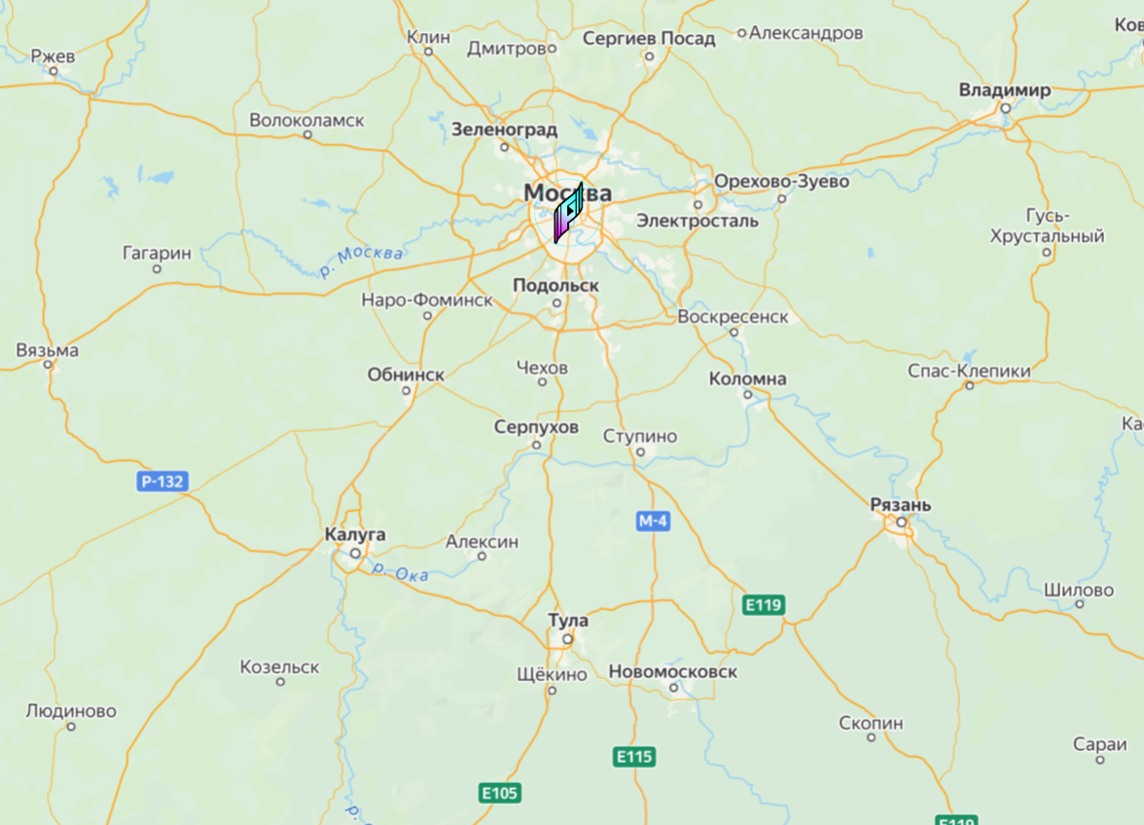
OBJECT OF PROJECTING
Goal 1
IFPS regional office creation
Tula State University| Space for New Opportunities
17

Slide 18

OBJECT OF PROJECTING
Resources 1
Marketing;
Staff (professional trainers);
Equipment;
Regulatory documents;
Grant support of Rosmolodezh
Tula State University| Space for New Opportunities
18

Slide 19

OBJECT OF PROJECTING
Goal 2
LLC “Phygital Space” opening to train high-qualified phygital sportsmen
+ Creating of official website;
+ Space expansion.
Tula State University| Space for New Opportunities
19

Slide 20


OBJECT OF PROJECTING
Resources 2
Student start-up
“MY BUSINESS”
Tula State University| Space for New Opportunities
20

Slide 21
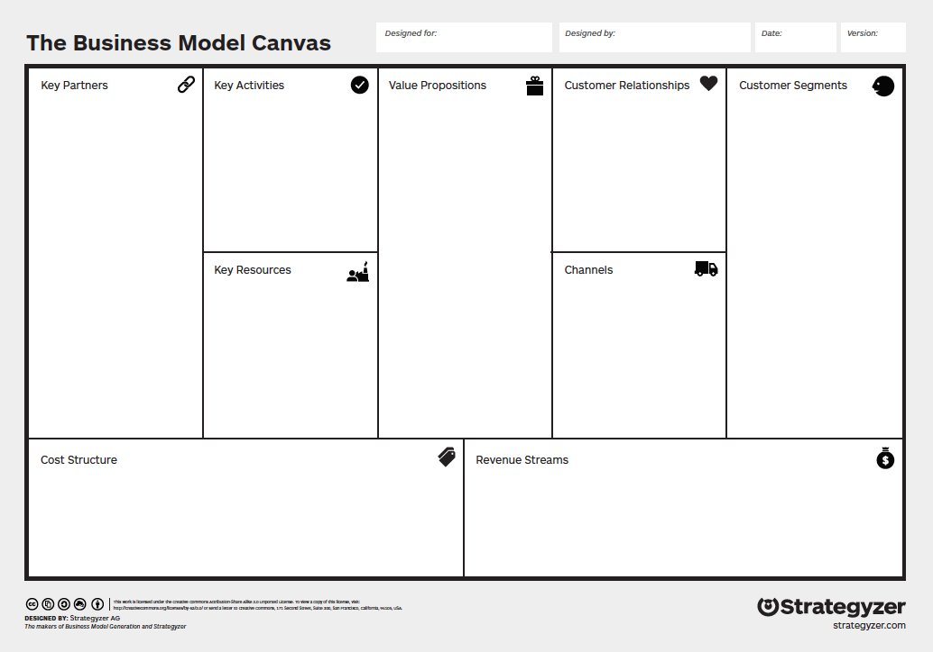

















Self-realization
Personal and team rating
Ministry of Sport
Media Coverage
TSU Students and Entrants
Modern equipment
Tula State University
Russian Federation of Phygital Sport
Sportsmen and cyber sportsmen
Team work
Social Networks
Marketing
Personnel
Maintaining
Tournament Victories %
Paid visits
Tula State University| Space for New Opportunities
21

Slide 22
Benefit and Responsibility Matrix
Project solution
Entrant + rating in «Priority 2030»
Annual reporting improvement
TULA STATE UNIVERSITY
Regional presence expansion
Administrative and financial resources
TULA REGION MINISTRY OF SPORT
RUSSIAN FEDERATION OF PHYGITAL SPORT
Administrative
and information resources
Support in organization and work of regional centre
Tula State University| Space for New Opportunities
22

Slide 23
ROADMAP
Participation in Accelerator (TSU)
Conducting deeper analysis of the market
Our team will go to the Phydgital Games in Kazan
Timeline and milestones
Creation of the university's team in phygital sports
Promotion through platform “My business”
2023
2024
2025
2026
2027
2028
2029
2030
Tula Tournament
Web-site
Active Participation in Forums
Finding opportunities for grants
Preparing for the project
Getting Equipment
Workspace expansion
China
23
Notes:
Любой проект имеет свои временные точки, на основании которых мы можем говорить о том, что проект достиг определённых промежуточных целей. Опционально рассказать про milestones и происхождение термина дорожной карты

Slide 24
KPI
№ | Year | 2023 | 2024 | 2025 | 2026
1. | New disciplines | Football (Soccer) | Basketball | Hockey, CS-GO | Dota 2, Speedrun, Tennis, MMA
2. | Teams count | 2 | 4 | 8 | 16
3. | Training places count | 5 | 10 | 12 | 18
4. | Trainers count | 2 | 3 | 4 | 6
Tula State University| Space for New Opportunities
24

Slide 25
Resources
Administrative
of
Financial
Grant Rosmolodezh
Innovation Promotion Fund
Equipment
Ministry of Sport
Tula State University
Information
Other
TSU media
Accelerator TSU
FPS regional media
+PR
Staff
Tula State University| Space for New Opportunities
25

Slide 26
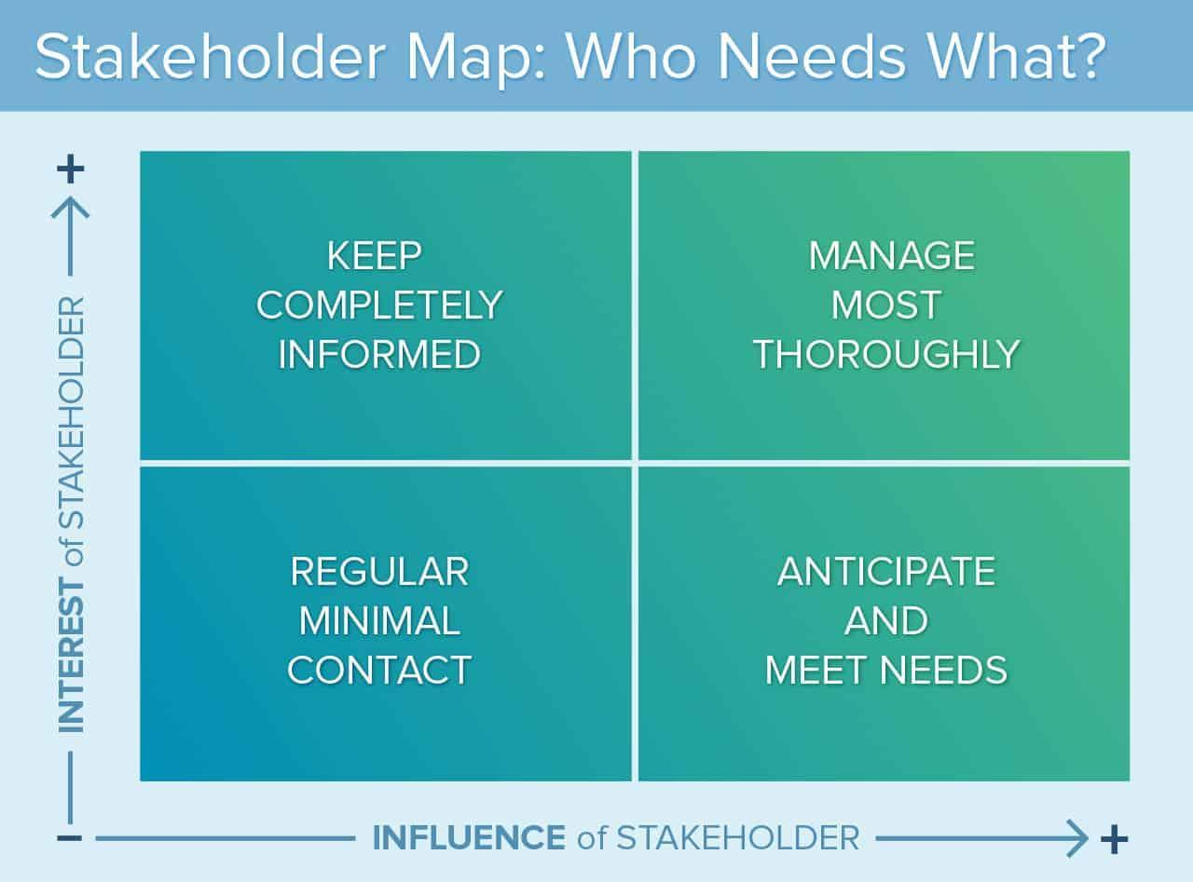
Stakeholder map
RUSSIAN FEDERATION OF PHYGITAL SPORT
TULA STATE UNIVERSITY
TULA REGION MINISTRY OF SPORT
Tula State University| Space for New Opportunities
26

Slide 27

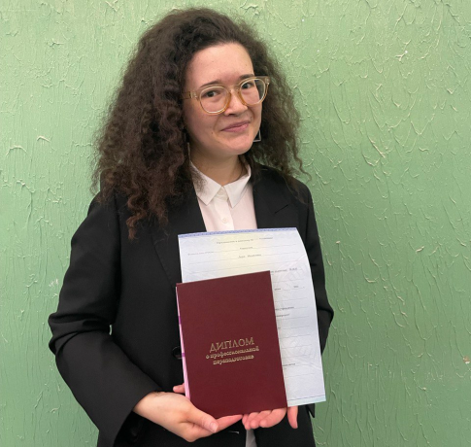
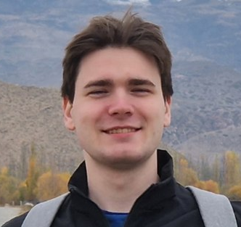
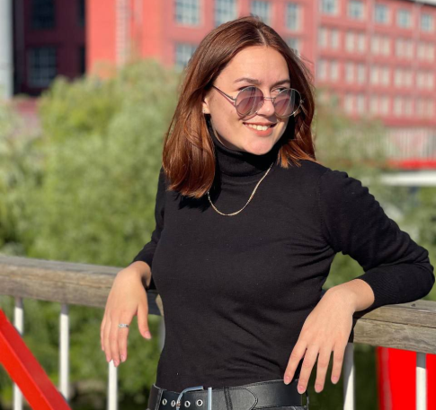

ROLES
CEO
MANAGER
WORKER
WORKER
Daria
Korshunova
Andrey
Korostin
Ksenia
Korneeva
Irina
Fomicheva
Tula State University| Space for New Opportunities
27

