Slide 1


Social network for customers
Saas product for business
http://apromt.ru/

Slide 2





:
Quickly generate and change loyalty programs without using paper or plastic!
Communicate with the seller anywhere in the world without knowing the language, and get a discount!

Slide 3
HOW DID OUR PRODUCT APPEAR?
Having accumulated more than 4 years of experience, working in a highly competitive small business environment (hairdressers), communicating with colleagues from other highly competitive business areas, I and the co-founders have created and are already starting to implement a product that makes life easier for both customers and business owners.

Slide 4

We want to give every
business a convenient product
(mobile app, WEB version), which:
allows you to hide your customers (competitors can not lead away);
allows you to quickly generate/change any loyalty program (monetization);
creates an analog of a personal mobile application for any type of business (monetization);
saves money on attracting customers in the form of promotional offers (monetization), etc.

Slide 5

We want to give every
customer a convenient product
(mobile app, WEB version) which:
allows you to communicate with the seller of goods and services anywhere in the world without knowing the language;
order different products in the store, make an appointment for a service/order a table and dishes, by a certain time;
it is convenient to store / present (show) digital discount cards, share promotional offers/bonuses with other users, etc.;
allows you to select goods/services according to your planned budget;
allows you to select the necessary goods/services according to the current location, so that you can view them personally.

Slide 6
VOLUME OF THE WORLD MARKET
РАМ – about 60 million small businesses;
ТАМ – about 30 million small businesses;
SAM – about 9 million small businesses
(2 160 000 000,00 $ per year);
SOM – about 2,7 million small businesses
(648 000 000,00 $ per year).
*taking into account the fact that each small business spends, on average, $ 20 per month on discount program, other digital products which allow to communicate with customers and retaining them are our indirect competitors.
Small business in Europe is main part of the EU's socio-economic development. There are over 23 million small and medium-sized businesses in the European Union.
Approximately 5 million firms in countries outside the European Union - Canada, Australia, New Zealand, Asia (excluding Japan), the Middle East and Africa, China have more than 4.3 million small and medium-sized enterprises and 27.9 million individual businesses.

Slide 7


Indirect
competitors
Business cards, plastic cards of loyalty programs
We give more and faster for less money!!!
In our social network, competitors do not see customers and cannot take them away. We initially build a product for the business, and do not adapt to the needs of the business, like our indirect competitors.
Social networks.
Mobile apps for businesses.
Our product is cheaper for business, more convenient for business and customer use.

Slide 8
Indirect
competitors
Services for distribution of promotional offers, advertising of businesses
Our product is much more convenient and quickly solves problems with placing promotional offers and promoting business + business immediately creates a loyalty program.
Apps for storing digital discount cards. CRM systems.
They do not work with our target segment (segment A). Technically and functionally, it is not easy, it takes a lot of time to understand the functionality.

Slide 9
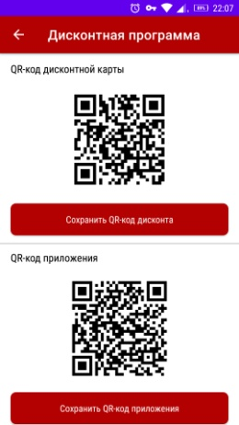
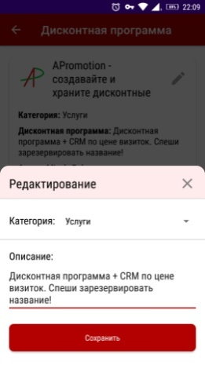
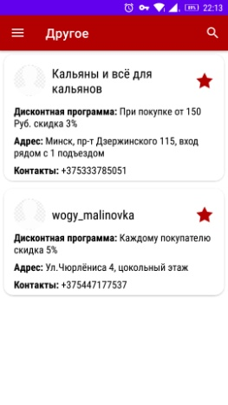
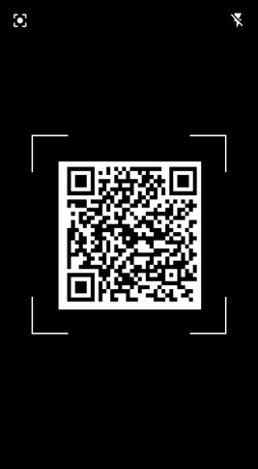
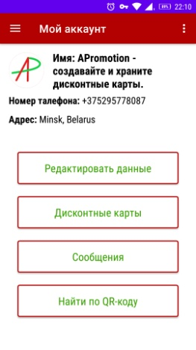
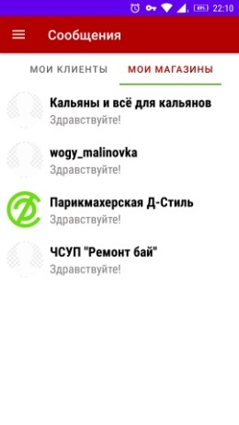
WHAT IS DONE AND ALREADY WORKING:
Creating / changing a loyalty programs
Saving / showing a discount card
Communication:
Client-business / business-business
*we have both Russian and English version of the app

Slide 10
Why APromotion is unique?
millions of users use CMS (Tilda, WordPress etc.) we make a similar product for mobile devices + ability to create loyalty programs (there are only indirect competitors);
many customers are looking for convenient apps for storing discount cards, including discount cards from small businesses that are expensive to buy plastic discount cards and equipment for loyalty programs; we give each business a cheap and simple decision, and every customer an easy way to store ALL the discount cards;
millions of users use products like Airbnb to search for the necessary goods/services. We give each type of business from any area an analog. The customer will be able to find necessary goods/services in any location, communicate with the seller without knowing the language, etc.

Slide 11
Why do we believe in APromotion?
We took all the best and necessary from our indirect competitors:
Social networks;
Apps for storing digitital discount cards;
CRM systems;
Online translators;
Digital platforms where offers for customers are
stored (goods/services) etc.
and we made a familiar and user-friendly product.
* every new product should be similar to the one which is being used now

Slide 12
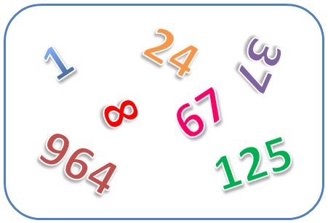
A little bit of numbers.
1 000 businesses, with 100 loyal customers = 100 000 users. With a conversion rate of 1%, this is else 1 000 drawn businesses.
The price for using our product will be $ 15 per month (creation/correction of loyalty programs), this is equal to 300 business cards in the RUS segment.
We will increase the check for using other paid features :
using a feature that gives the possibility to create an analog of a personal mobile app for business;
location of promotional offers to attract customers.

Slide 13
SOME MORE RESULTS FOR NOW
WITHOUT USING MARKETING:
- a custdev was conducted in British Columbia (Canada), to confirm the hypotheses - the English version is ready.
- The iOS version will be ready in one-two weeks.
- The Android version was tested on our own business, and in 1.5-2 months more than 60 clients started using digital discount cards.
- WITHOUT ADVERTISING, three businesses which are situated nearby (from segment A) became interested in the product, added their database.
- Following (segment A) in one of the social networks showed a conversion in more than 10% of subscribers.

Slide 14
DEVELOPMENT
After creating the WEB-version of the product and extended cabinets for the buyer and business, we will be able to:
- to expand the sales funnel, offering medium-sized and large businesses a tool for building flexible loyalty programs (including partner loyalty programs), at a price lower than their capital and operating costs for existing solutions.
- customers will be able to give each other bonuses, discounts, promotional offers, gift certificates, etc. around the world.
- with the development of 5G / 6G networks and use 2nm processors in smartphones (release scheduled for 2024/25) transfer and supplementing the functionality with augmented reality.

Slide 15
MARKET ENTRY
In addition to venture investors, we can be useful for chain retail, mobile operators, and the banking sector, because our product gives “unfair” competitive advantages in collaboration.

Slide 16
INVESTMENTS:
- We need investments for relocation from Belarus and hiring 5 employees. The volume is about 400,000.00 USD. This amount will make it possible to break even in a year.
- With an investment of 1,000,000.00 USD, we will be able to close the issues specified in clause 1, and within 2 years come to a profit which means no need in investment rounds anymore.
NOTE: a business plan is ready for the implementation of the project in Belarus. However, due to certain circumstances, I would not like to implement the project in Belarus, because the funds allocated for the project may be at risk. I am ready to discuss all questions in detail personally. The project is still being implemented at the expense of our own forces and funds.

Slide 17
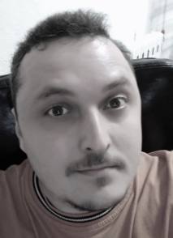
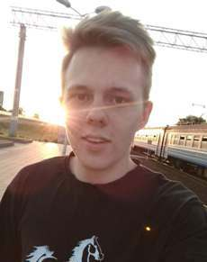
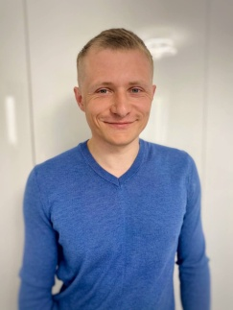

Founder of the project - Deniskin Sergei Evgenyevich
Higher education, lawyer. More than 4 years old entrepreneur. Reserve officer of the Border Troops, held command and analytical positions. For about 5.5 years he has been involved in the creation of software for border crossings.
Co-founder – Drankevich Vitaliy Petrovich
Android developer working in a specialty. Experience in creating mobile trading applications. Graduated from college, currently a university student in a correspondence course.
Co-founder – Metelskiy Aleksei Aleksandrovich
iOS developer. Higher education, economics and enterprise management. Held positions: deputy director at the enterprise, marketing and sales of IT products.
The co-founders signed a preliminary agreement (Article 399 of the Civil Code of the Republic of Belarus) on the division of shares.
+375 29 577-80-87 Sergei Deniskin (CJ Deniskin)
e-mail: forborder@mail.ru

